Slide 1
SPATIALIZING CONGESTION
Preliminary results

Slide 2
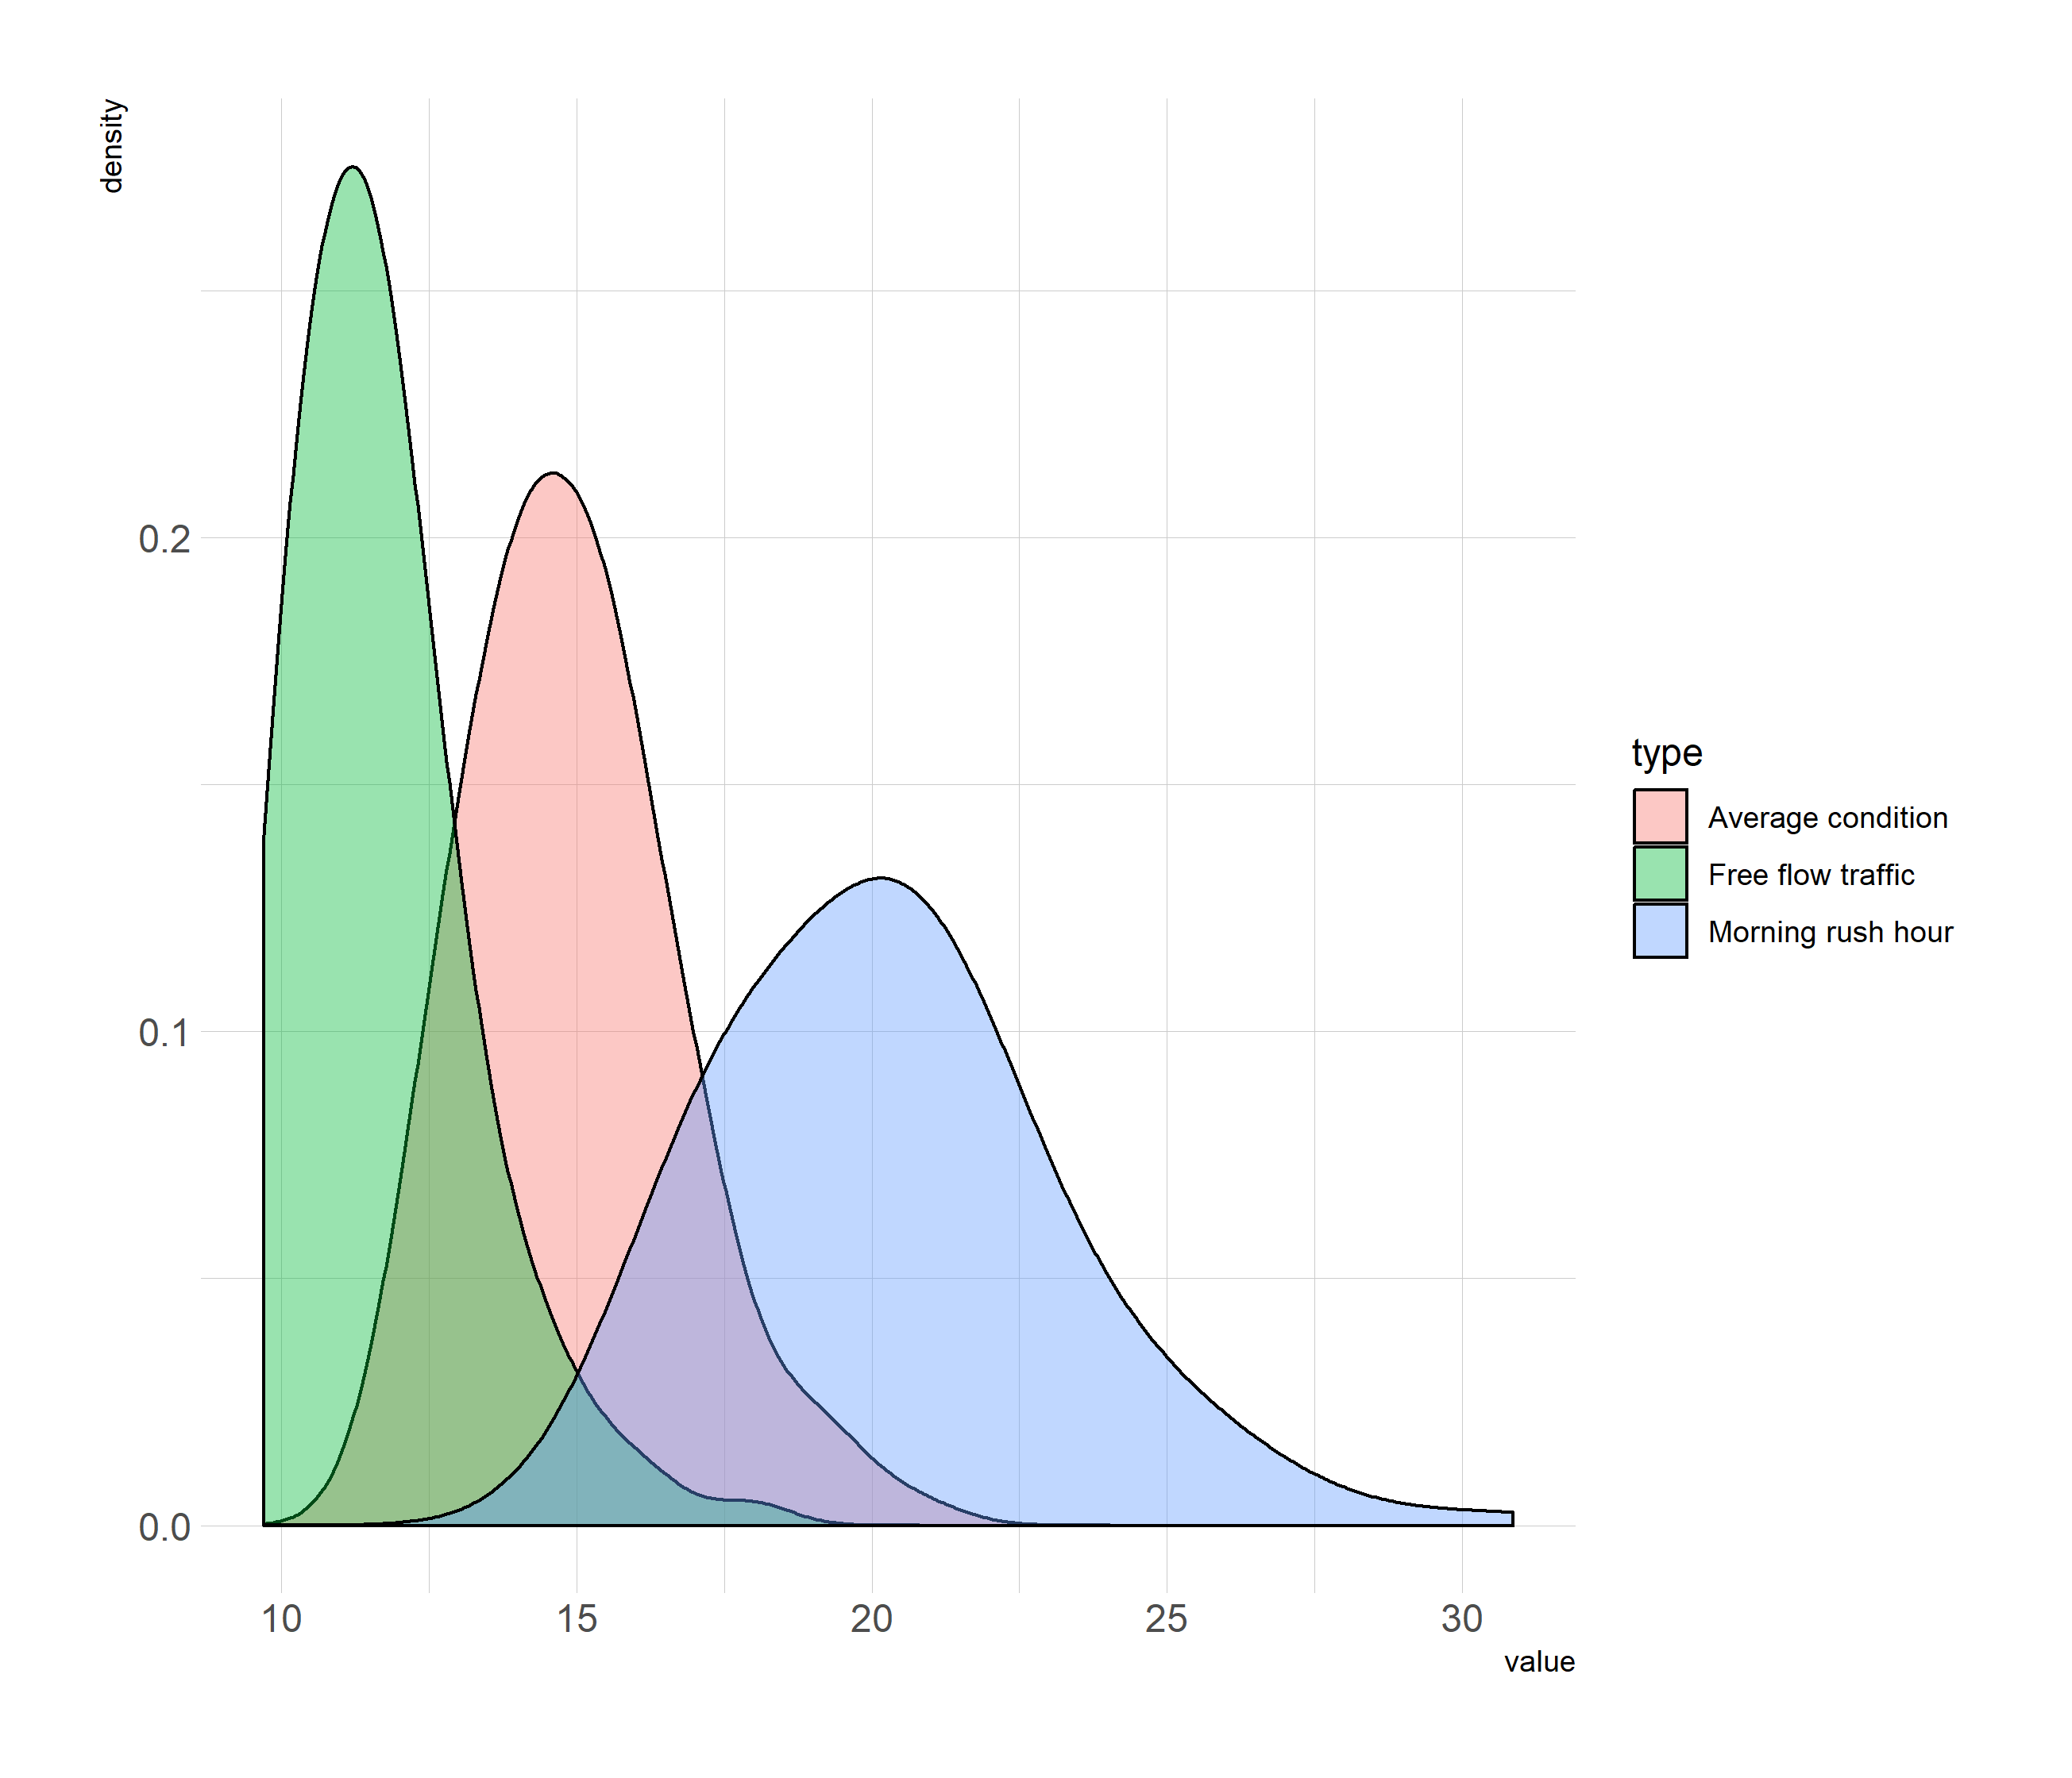
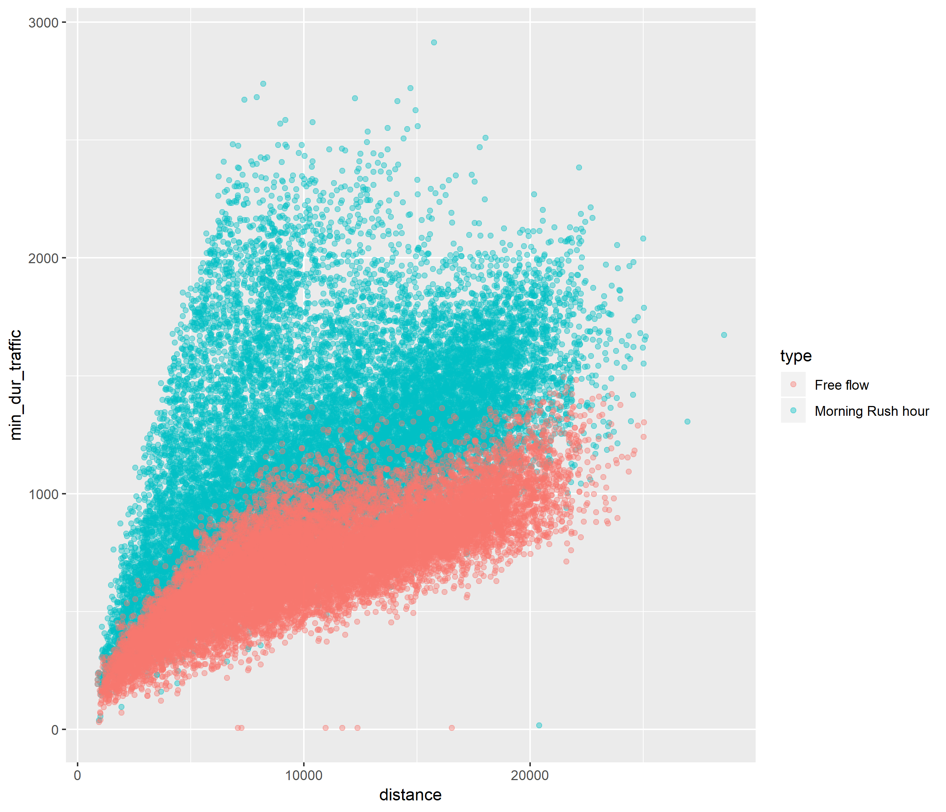
Amsterdam

Slide 3
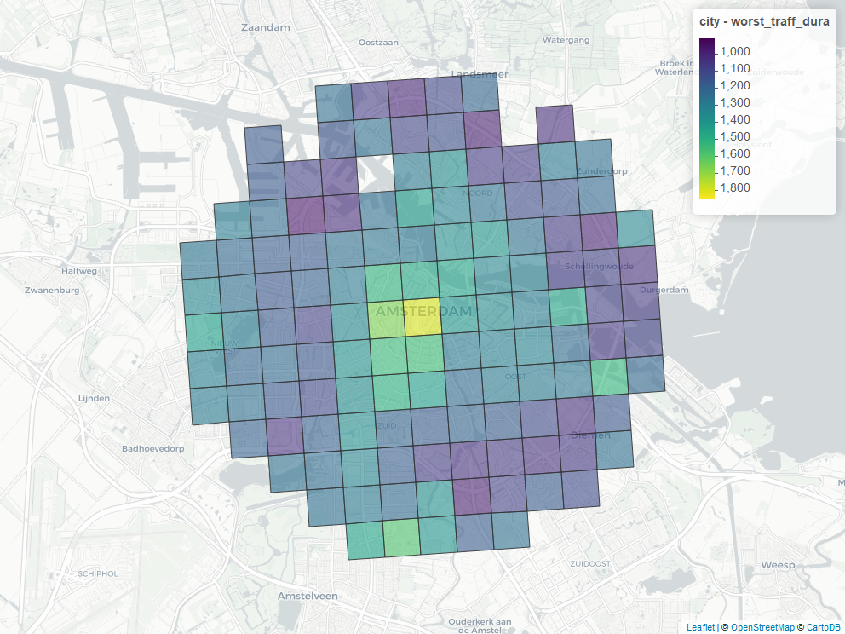
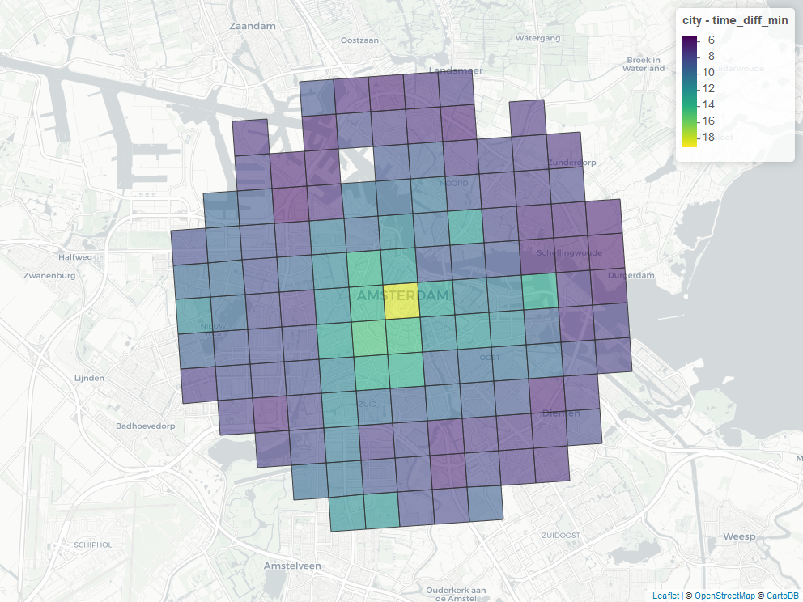
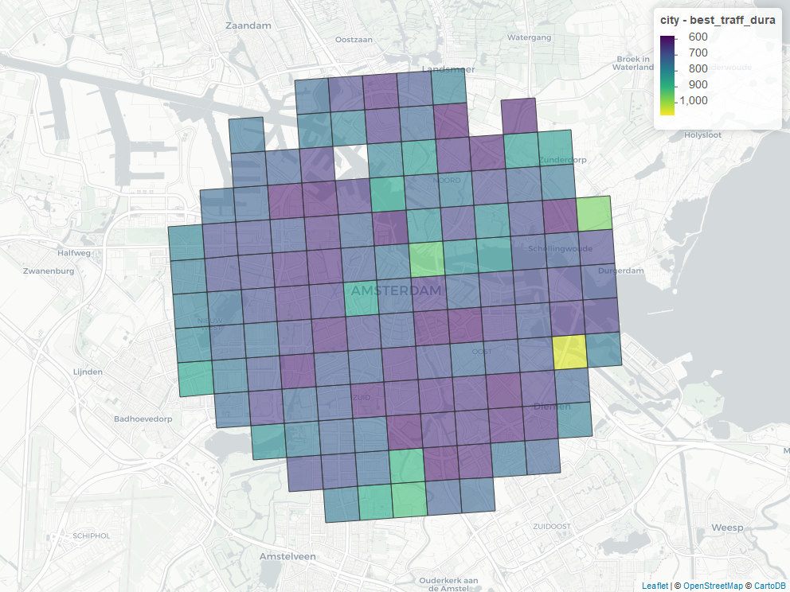
Amsterdam

Slide 4
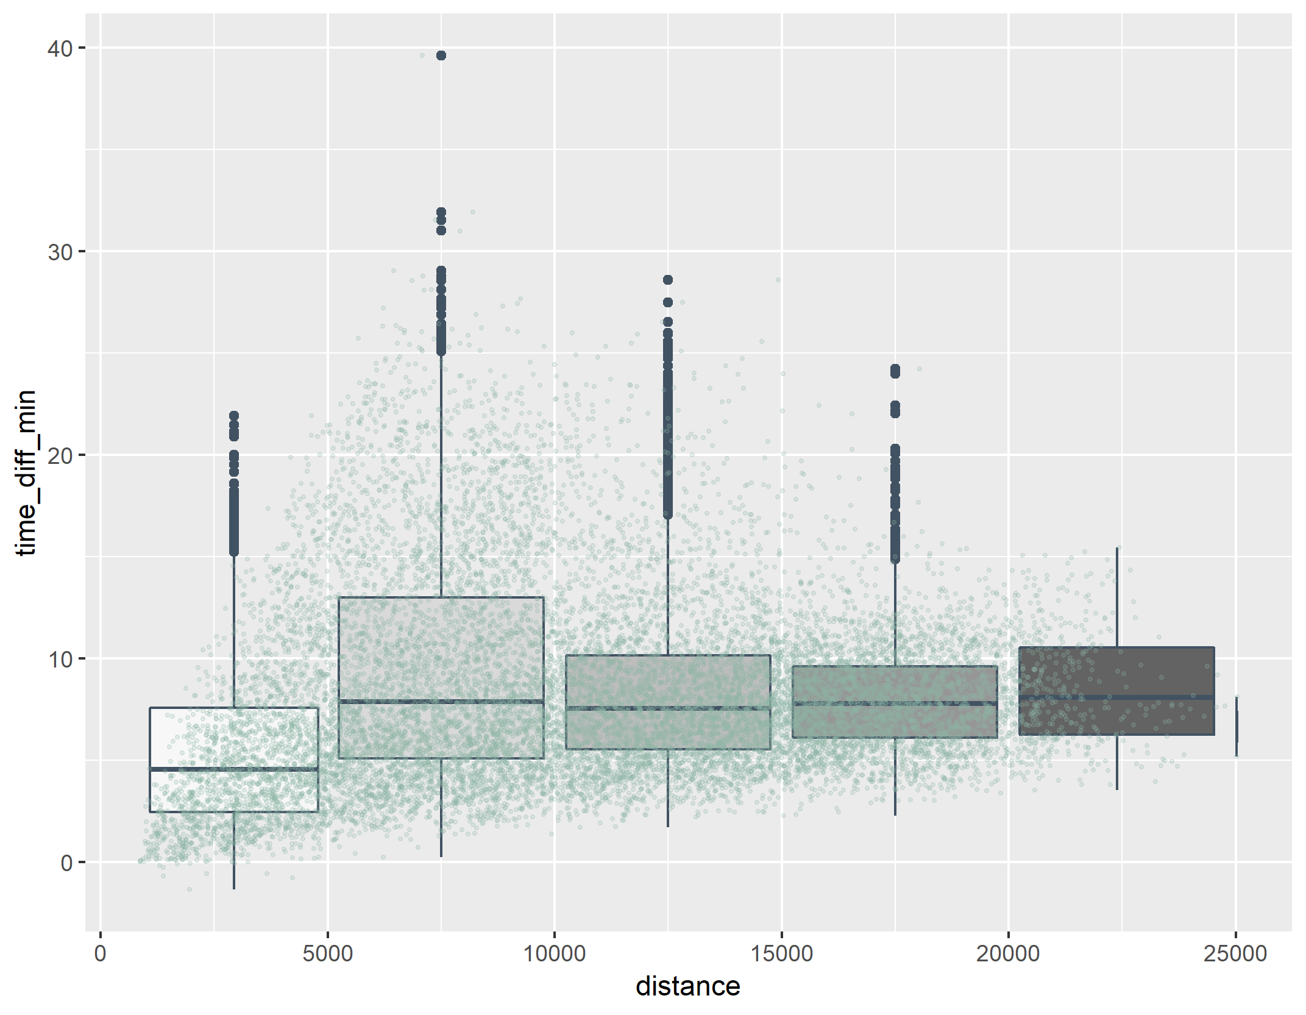
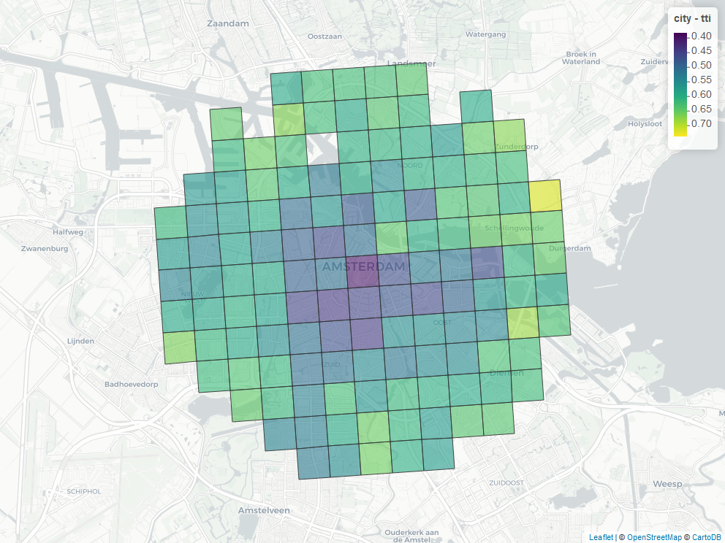
amsterdam

Slide 5
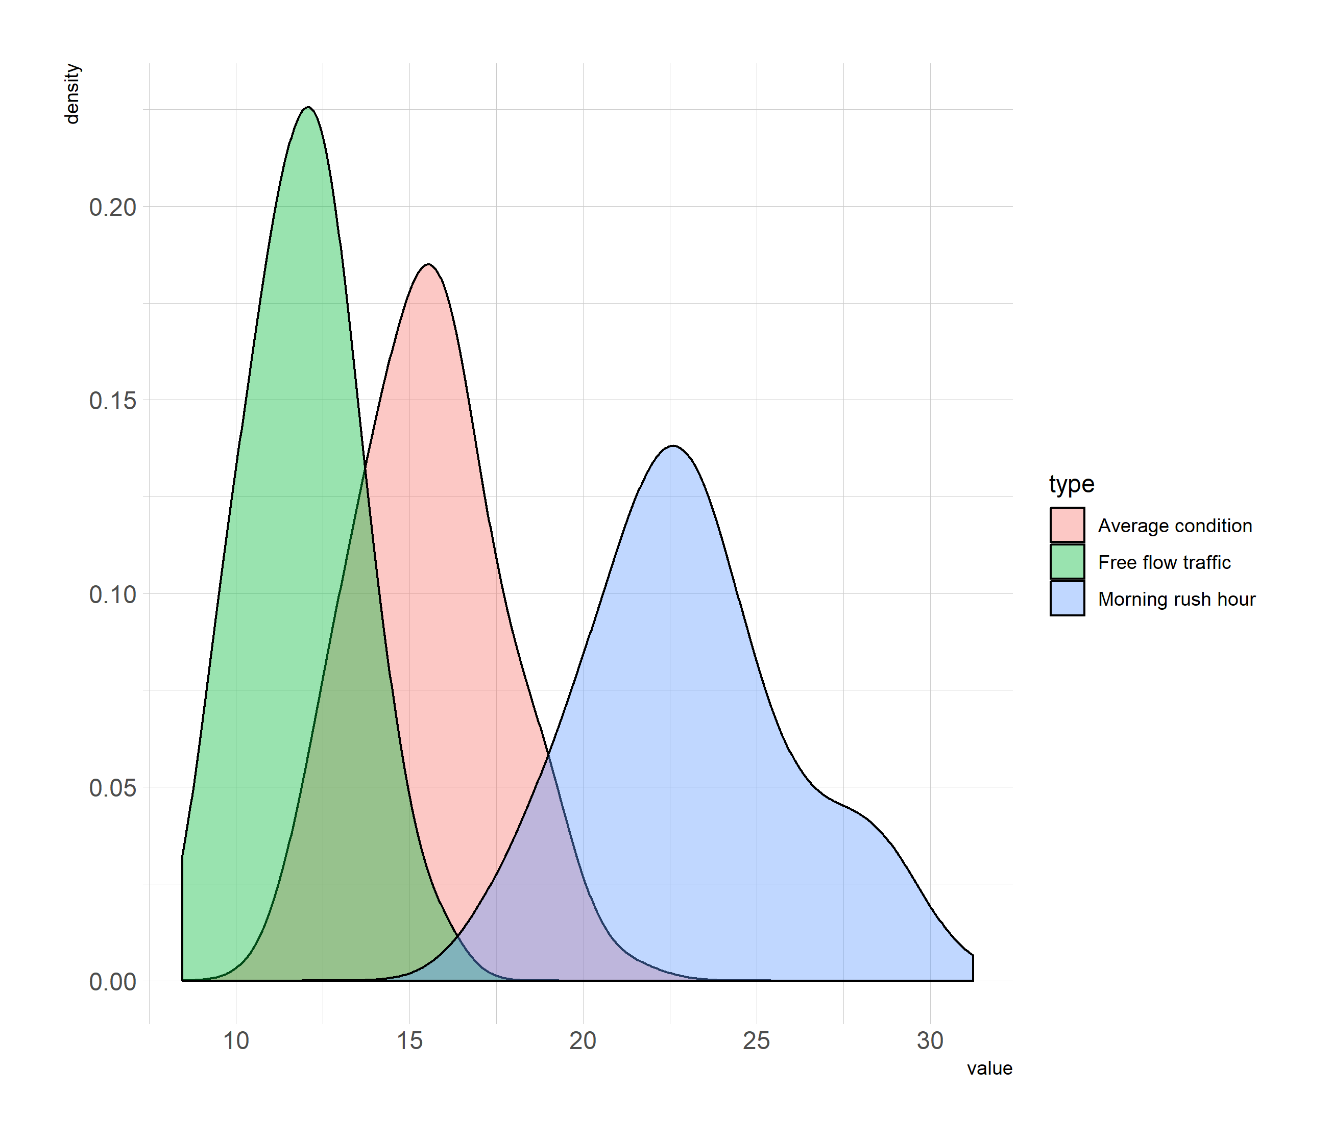
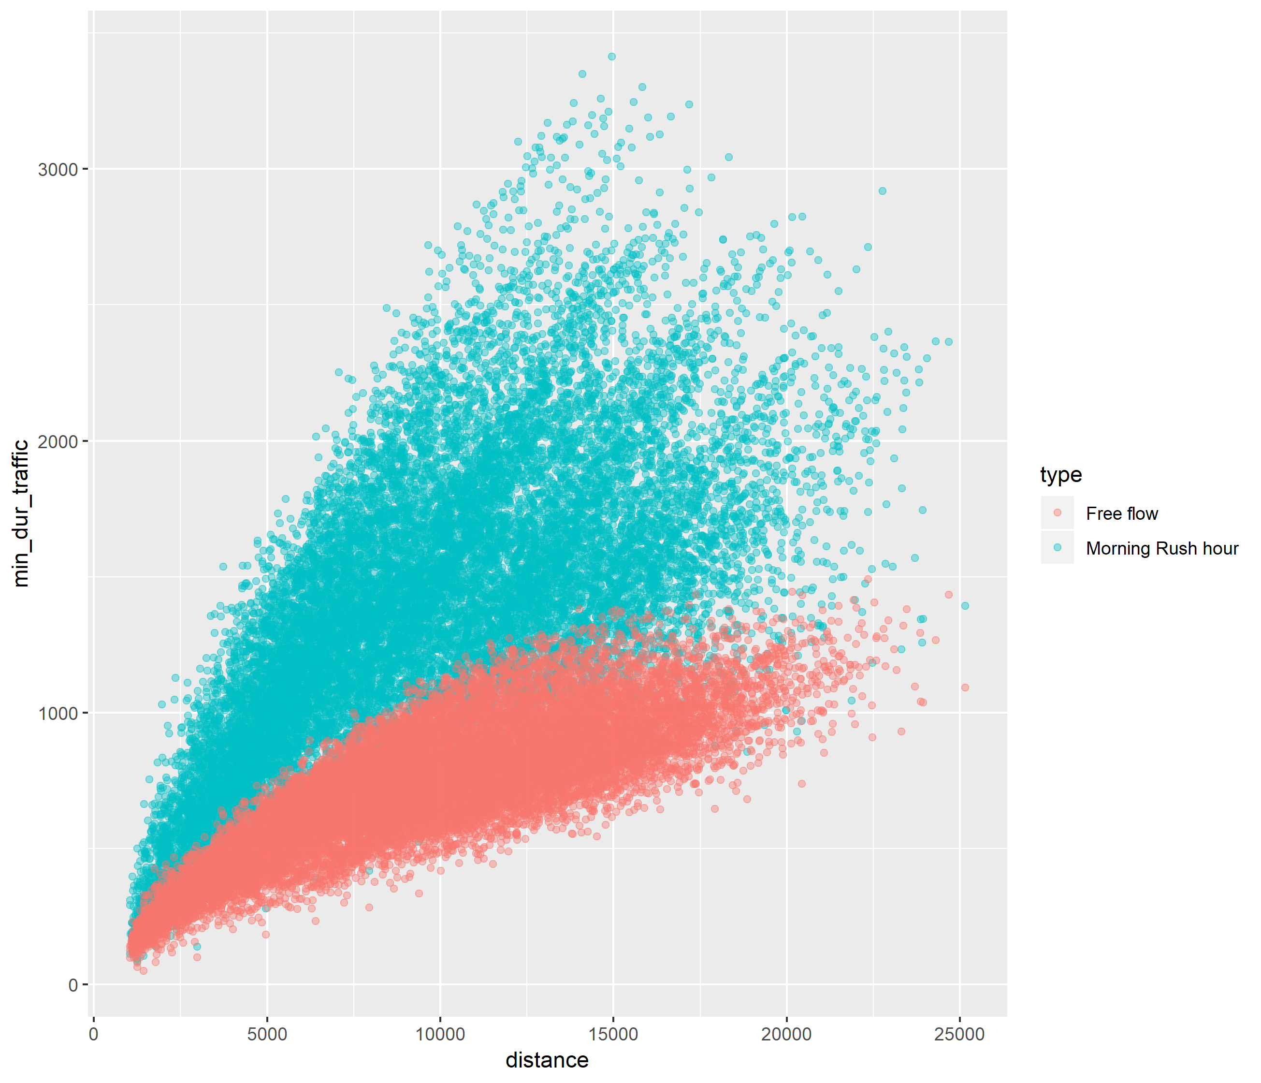
Glasgow

Slide 6
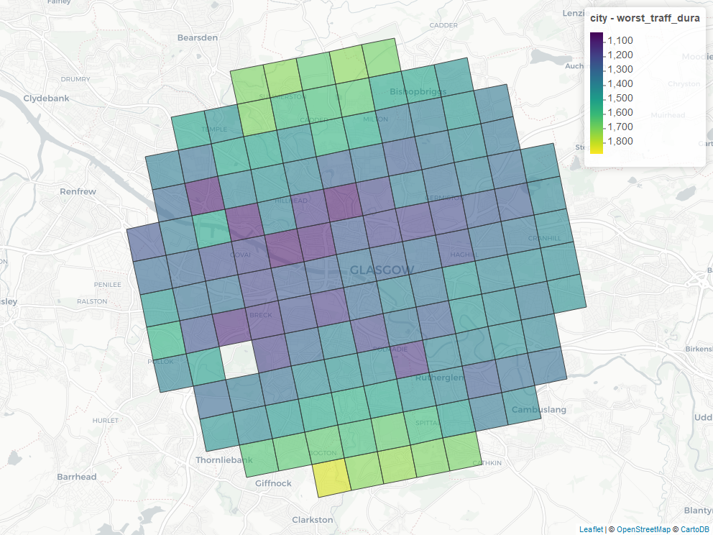
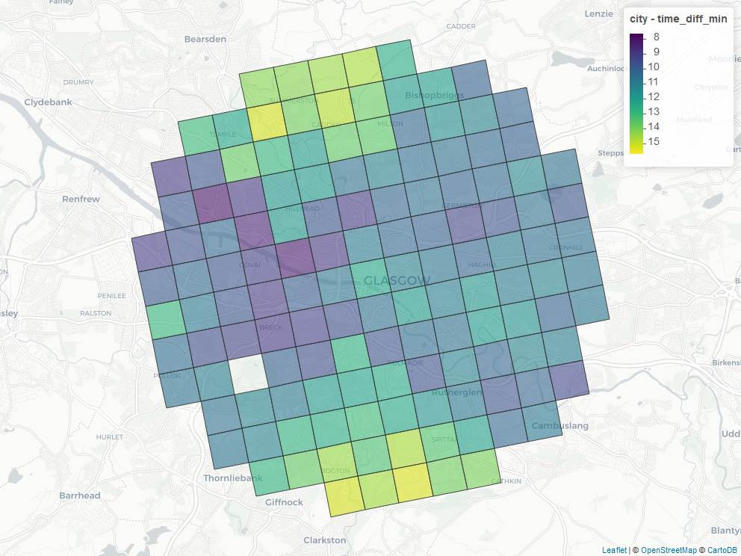
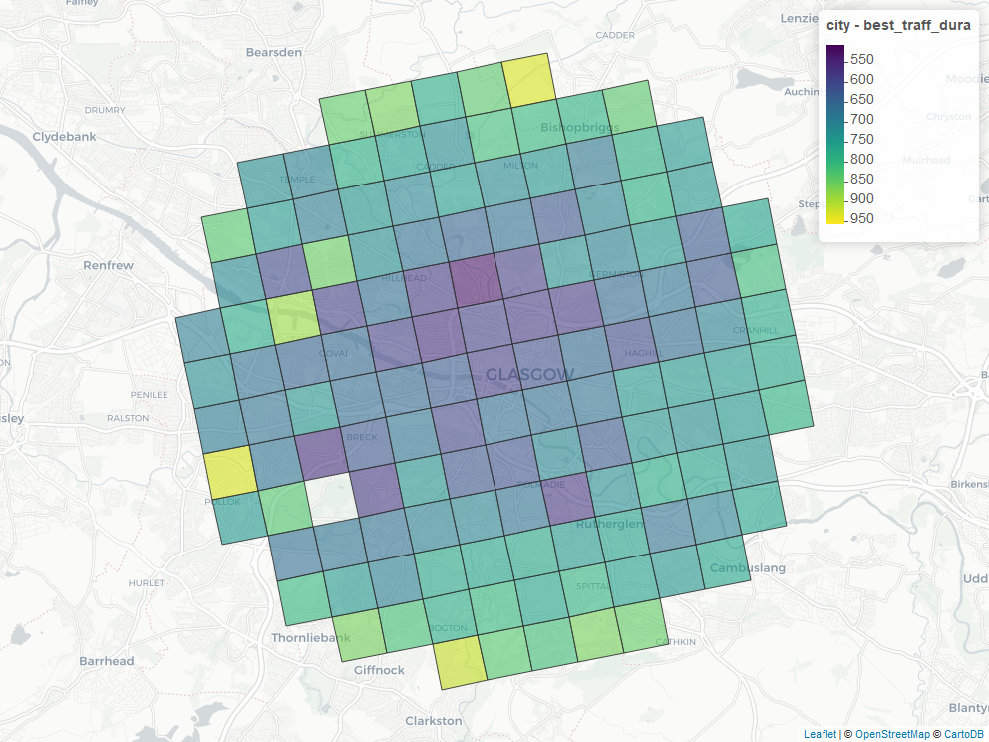
Glasgow

Slide 7
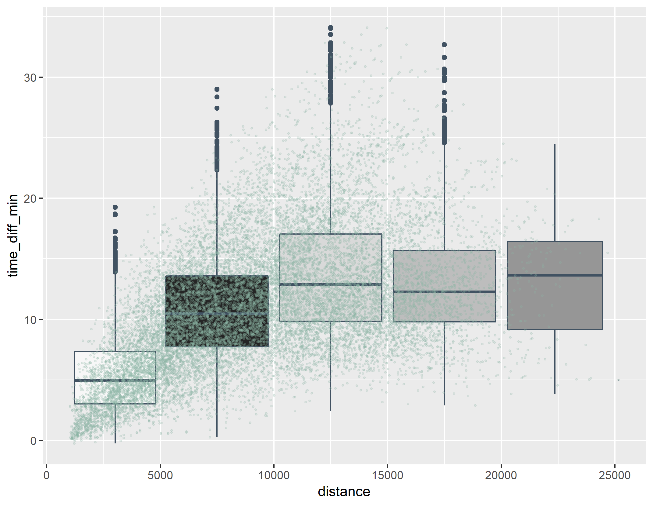
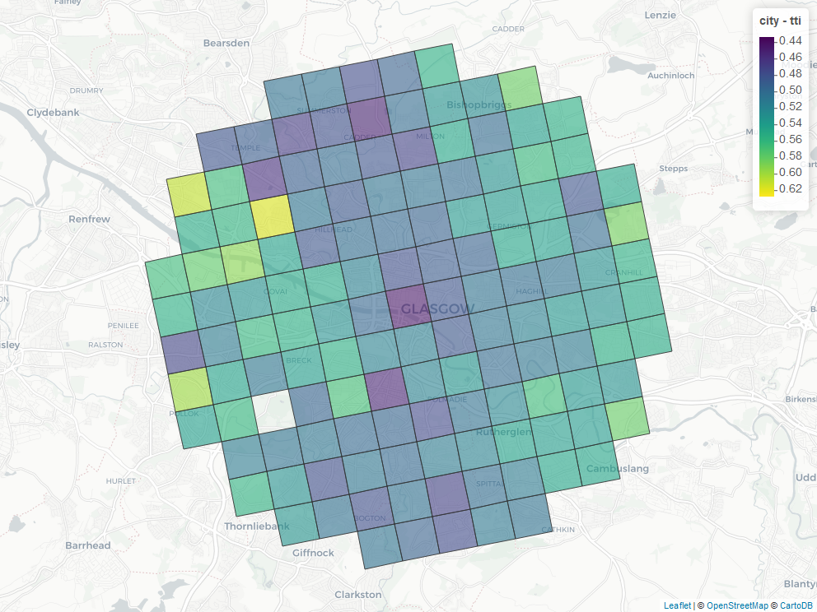
glasgow

Slide 8
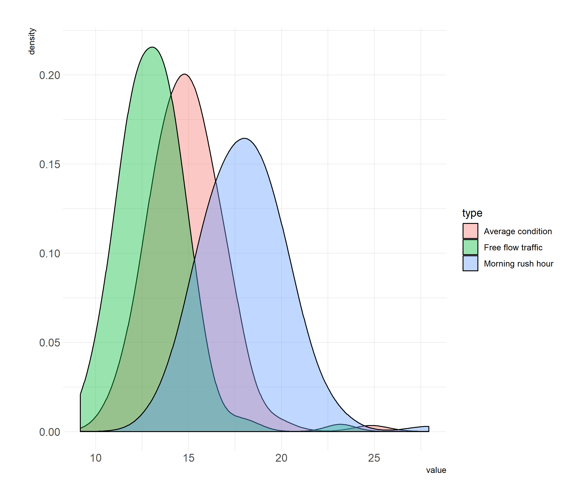
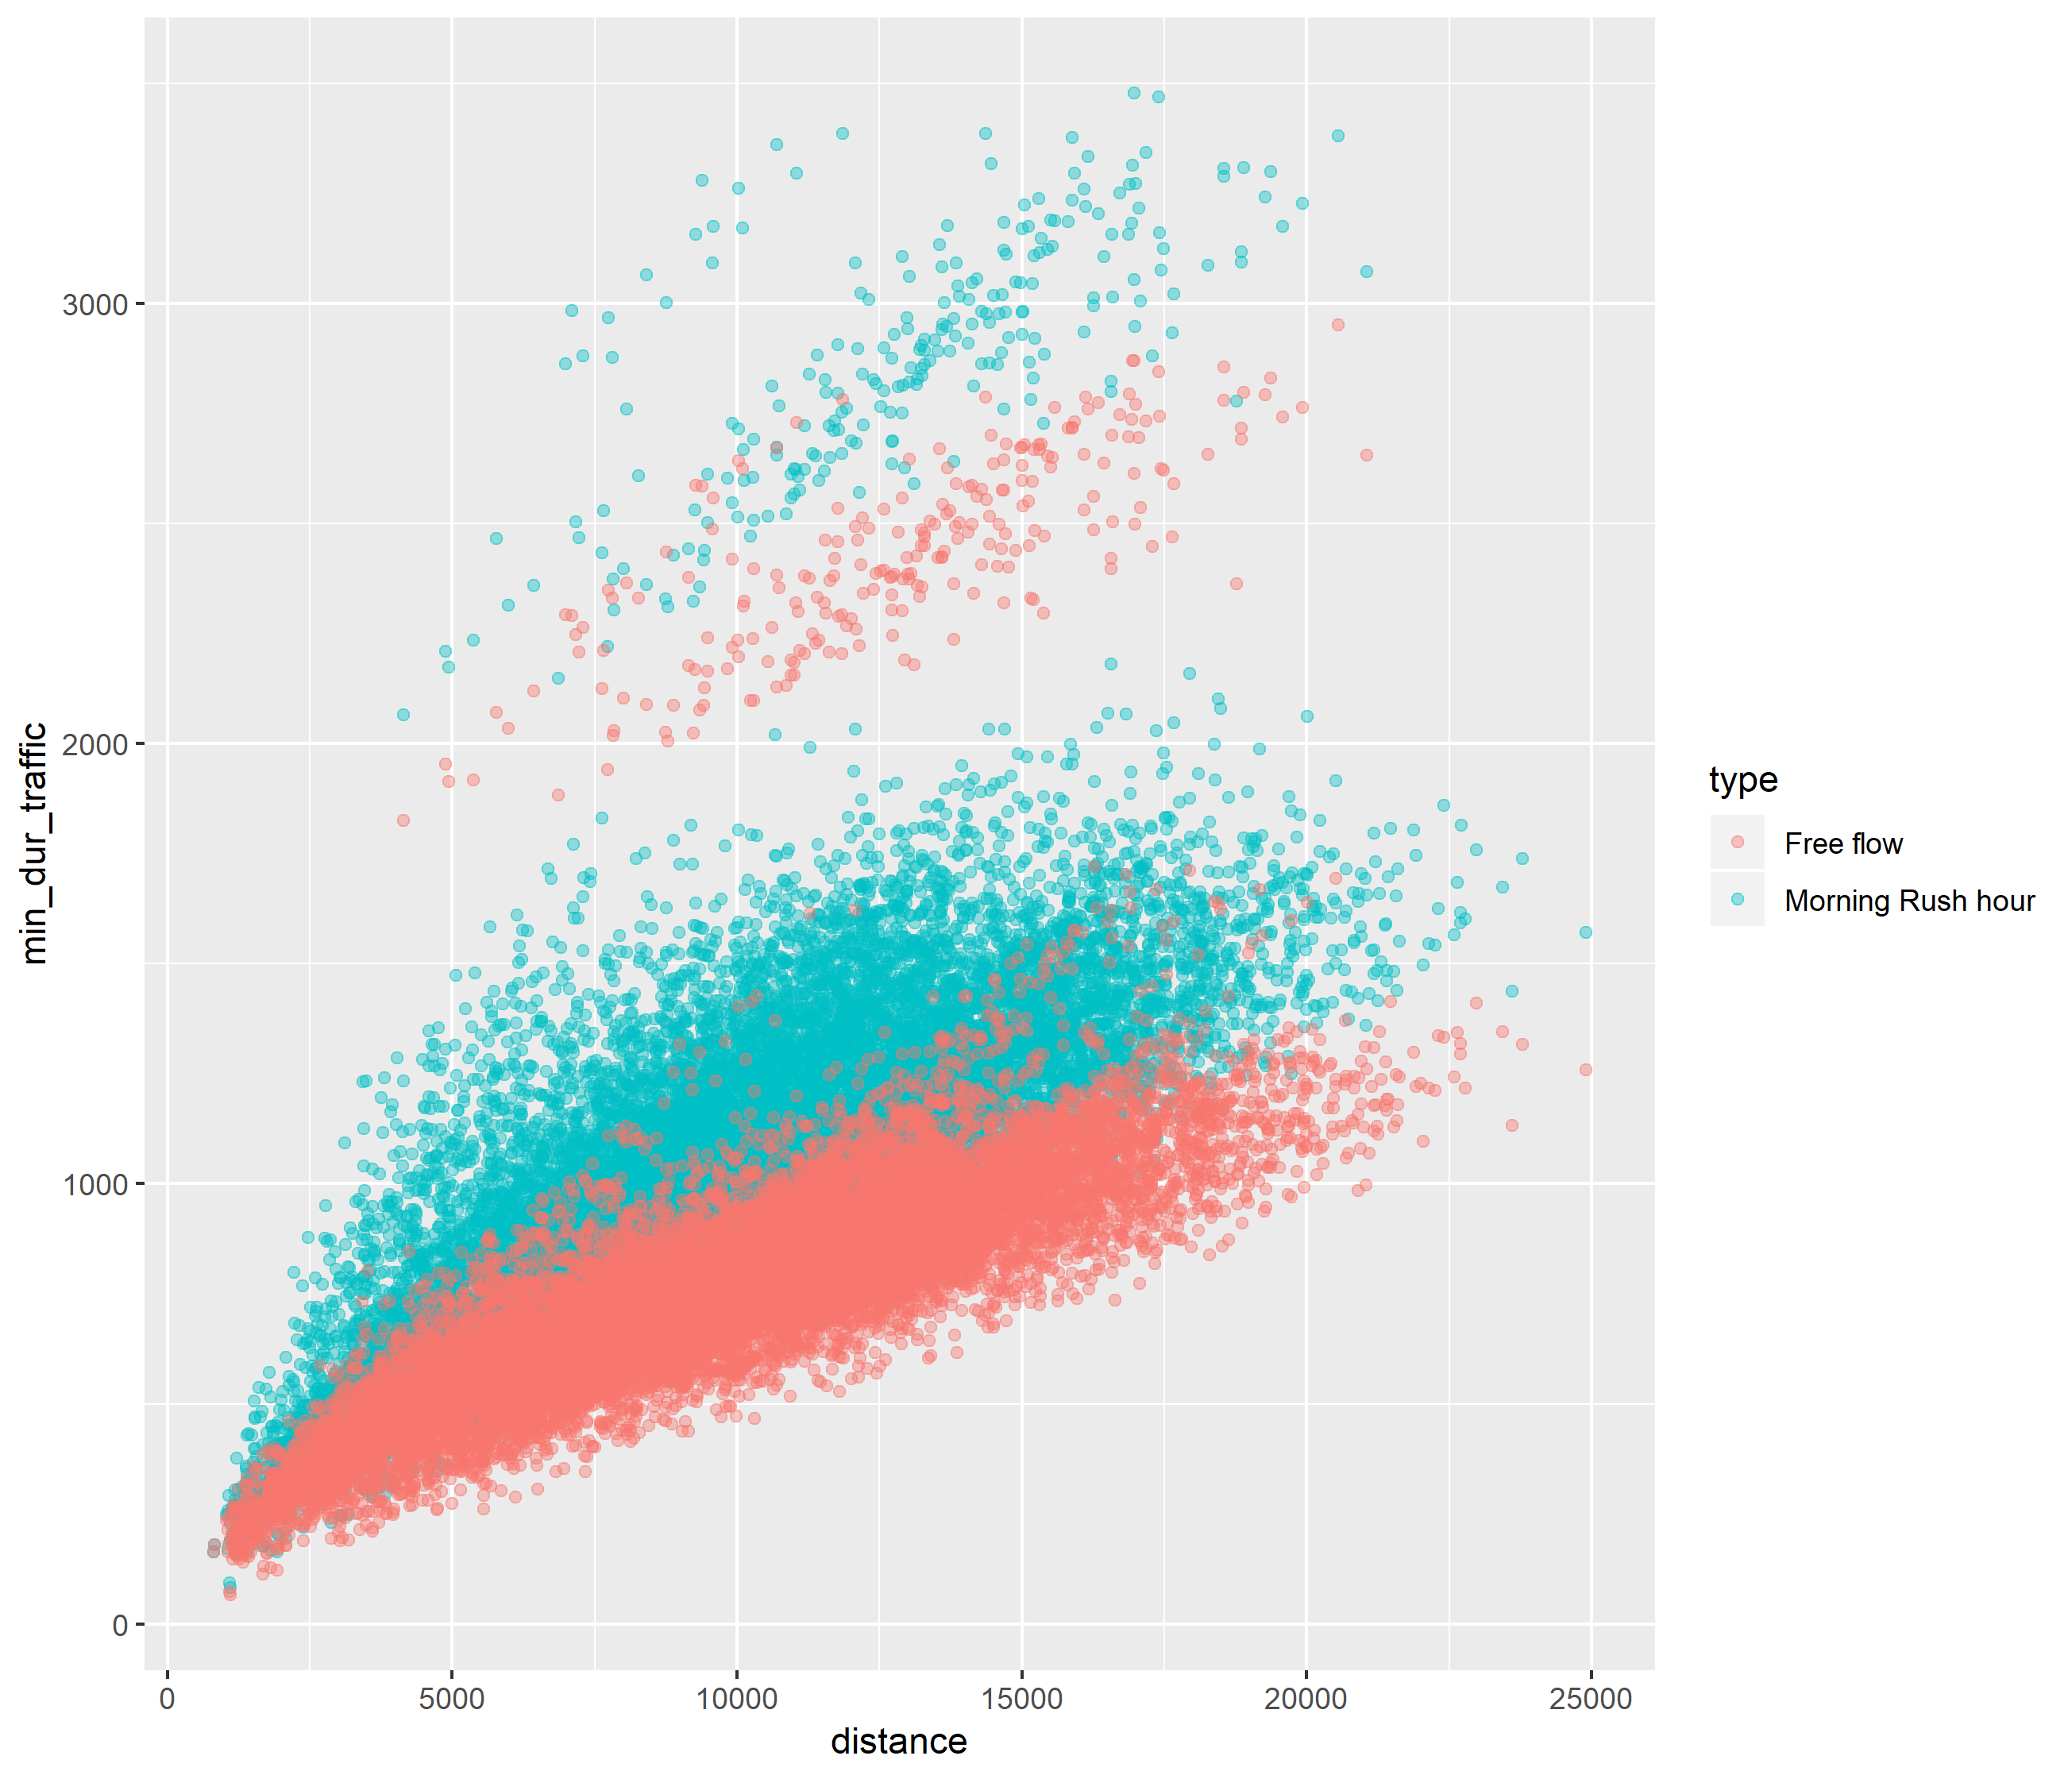
Goteborg

Slide 9
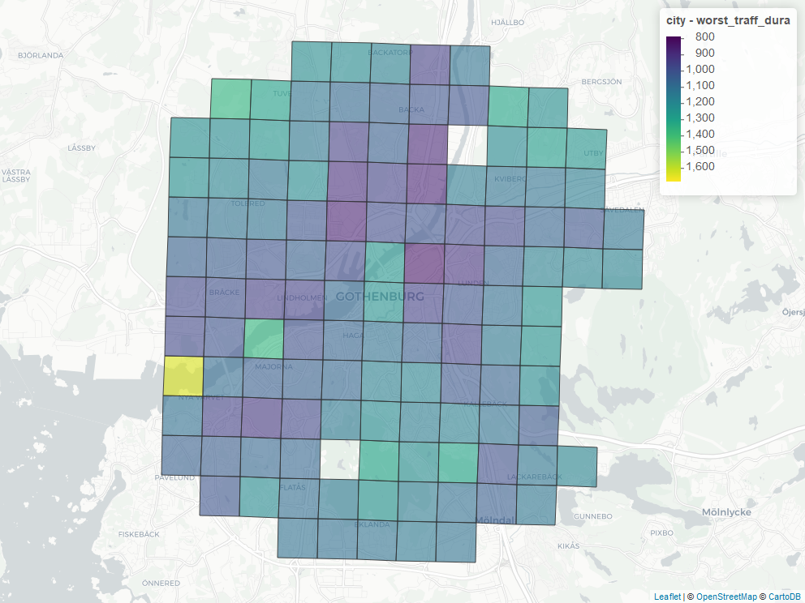
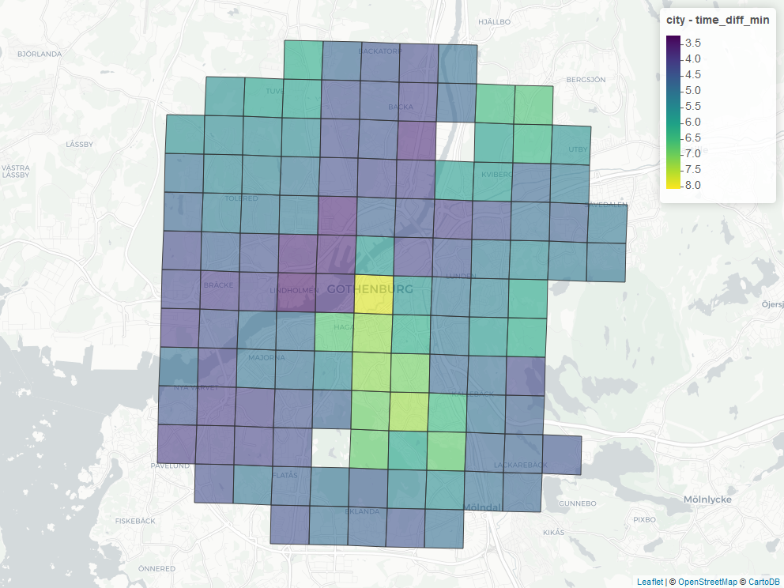
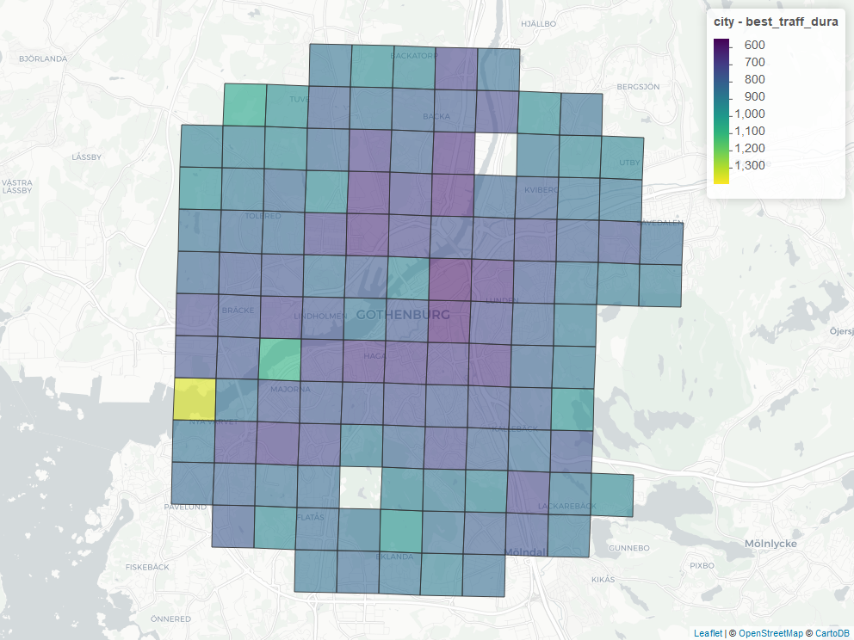
Goteborg

Slide 10
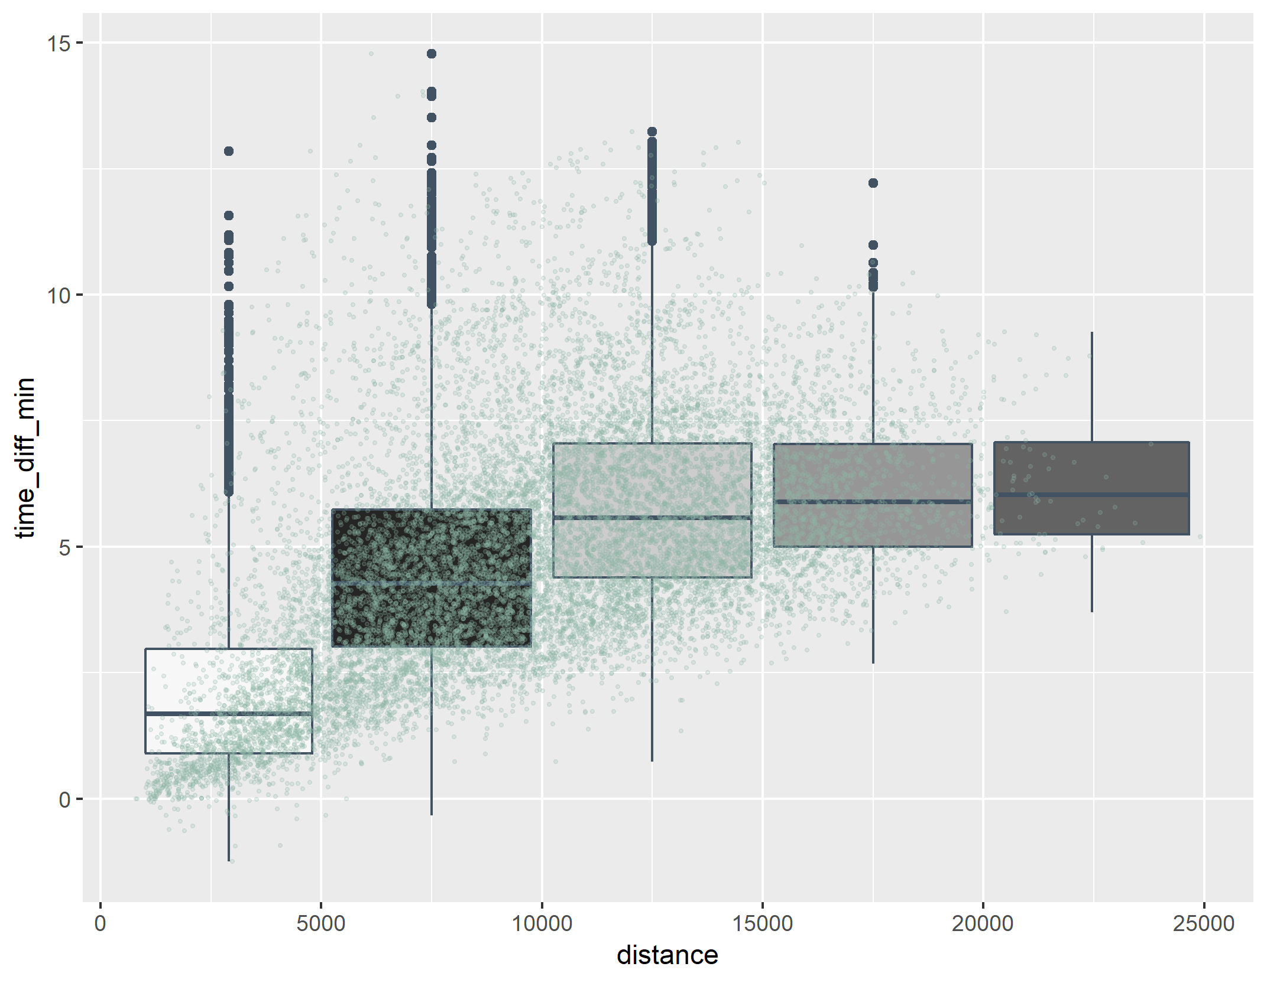
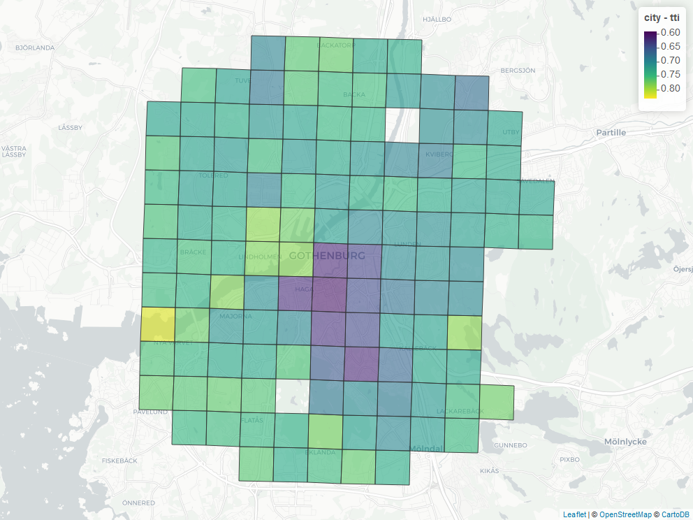
goteborg

Slide 11
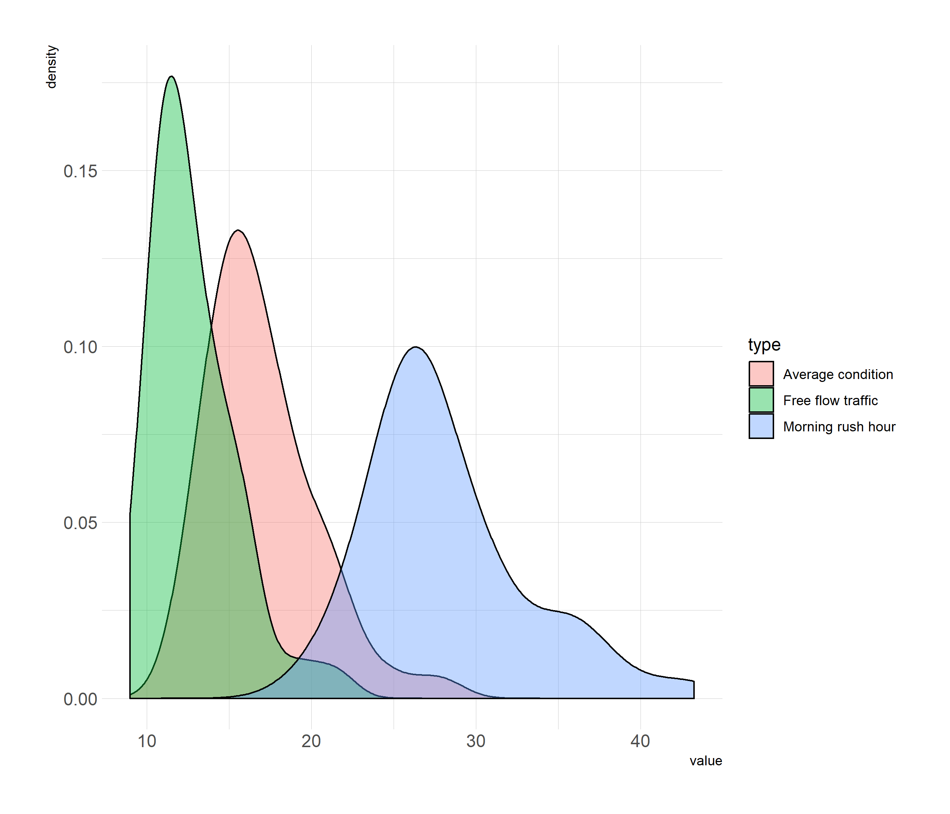
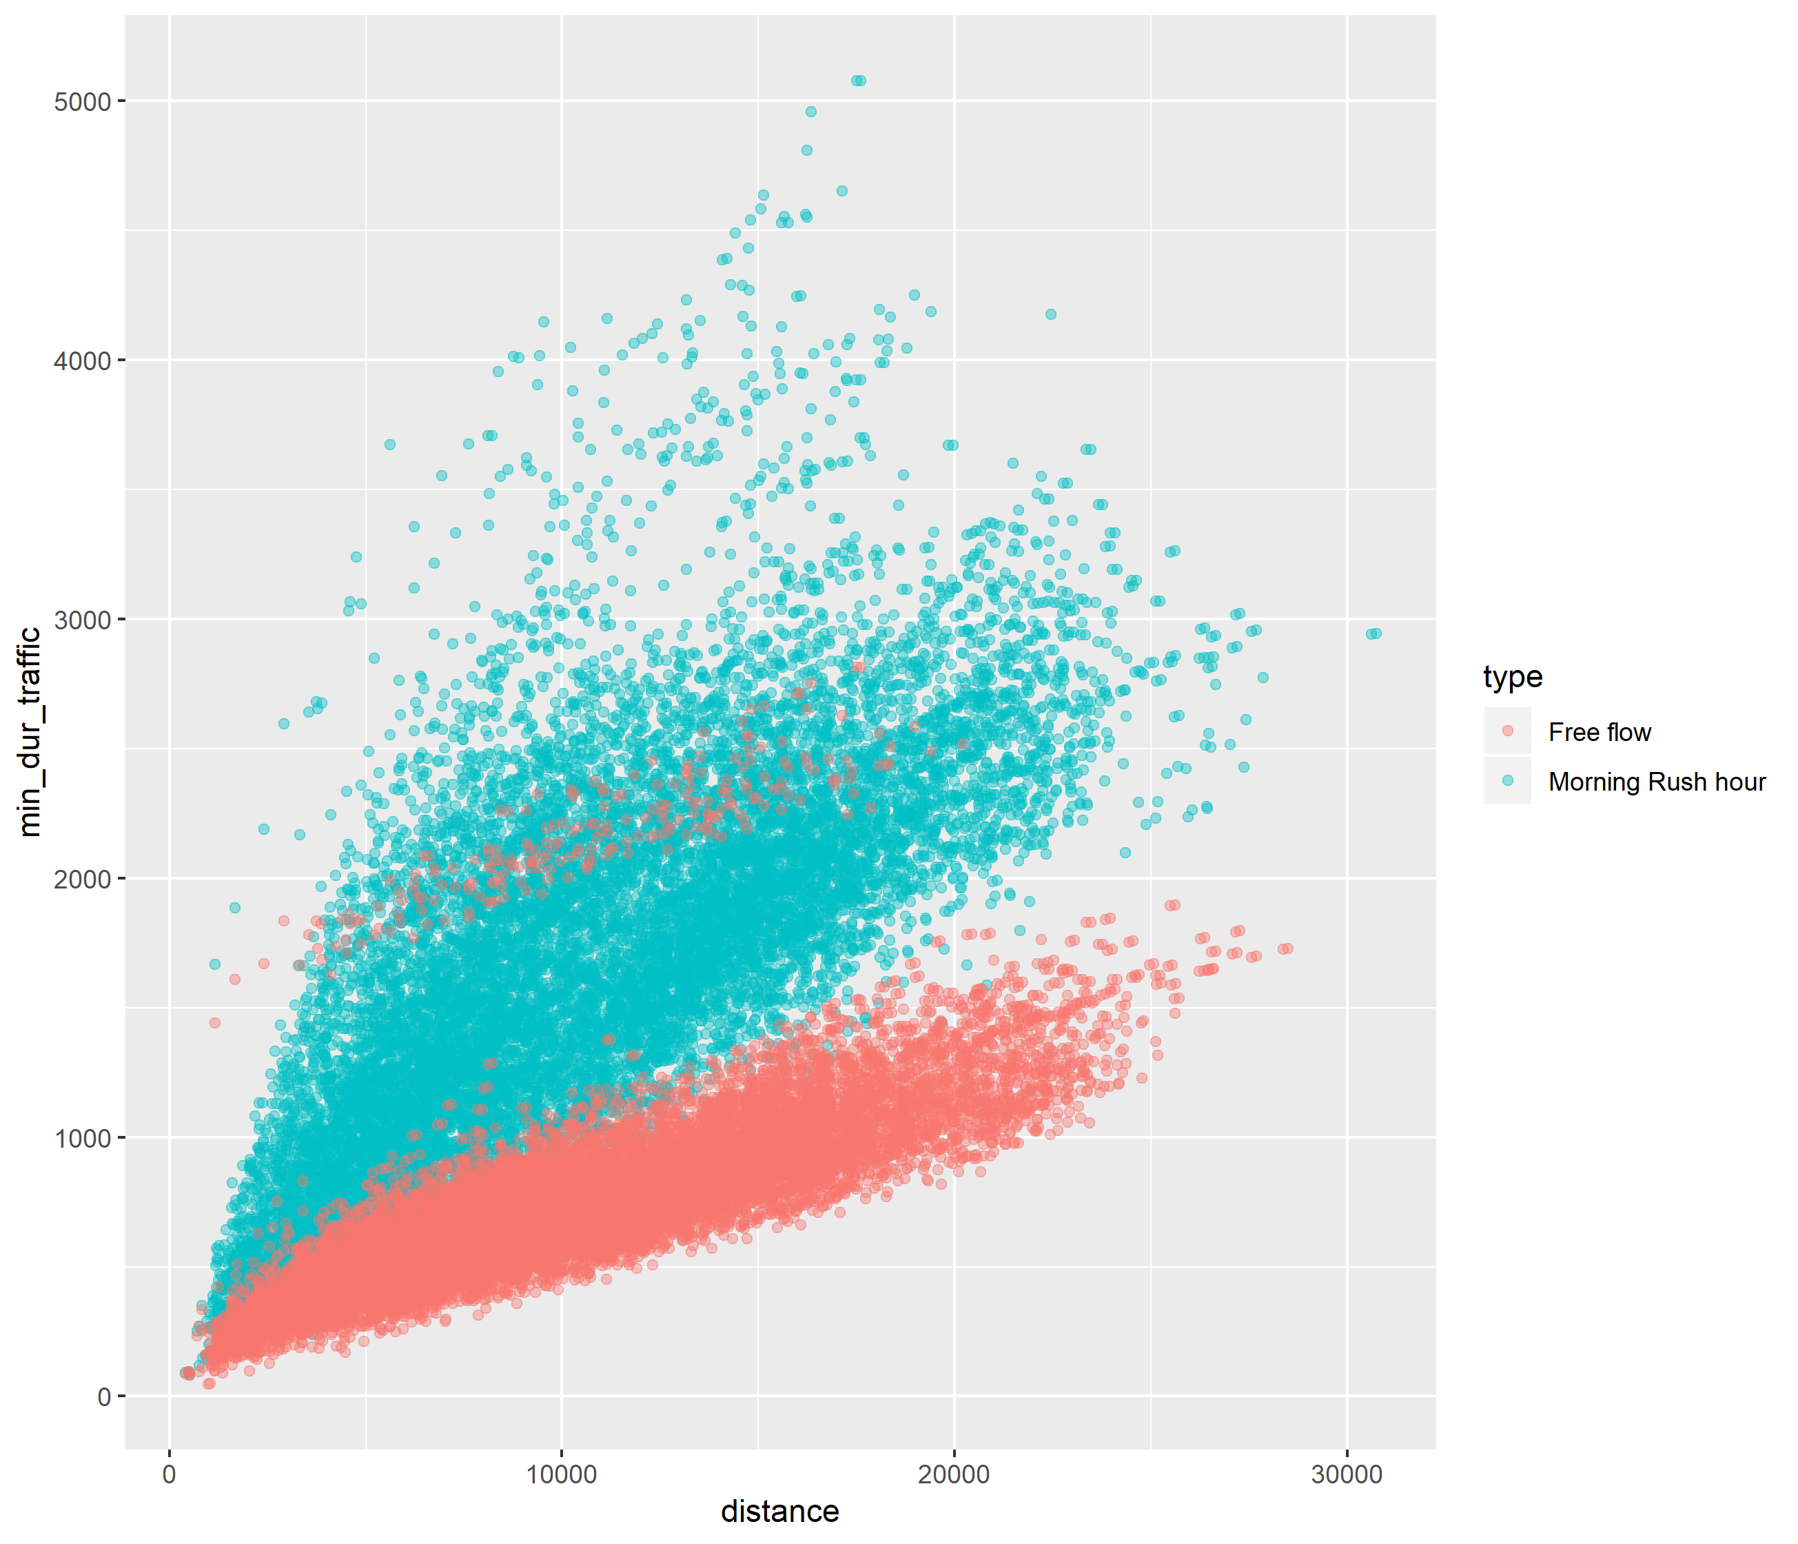
LISBON

Slide 12
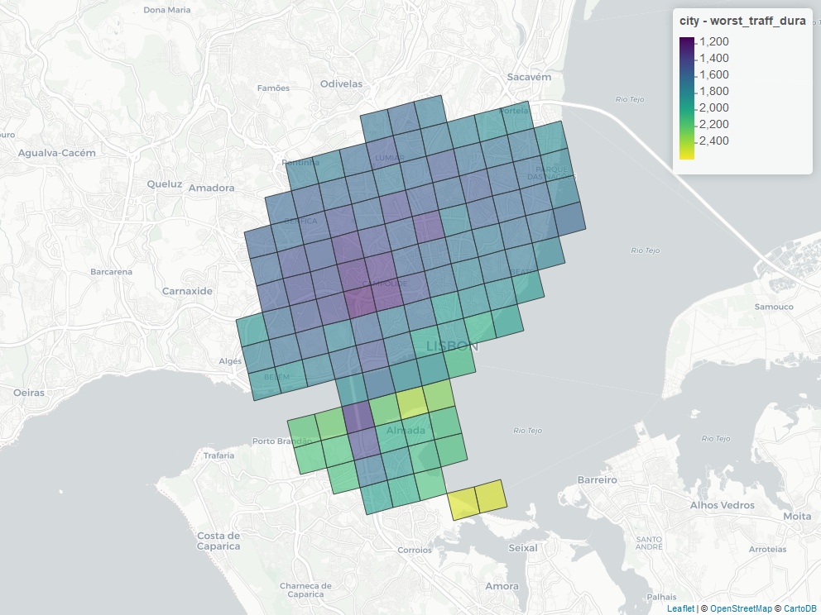
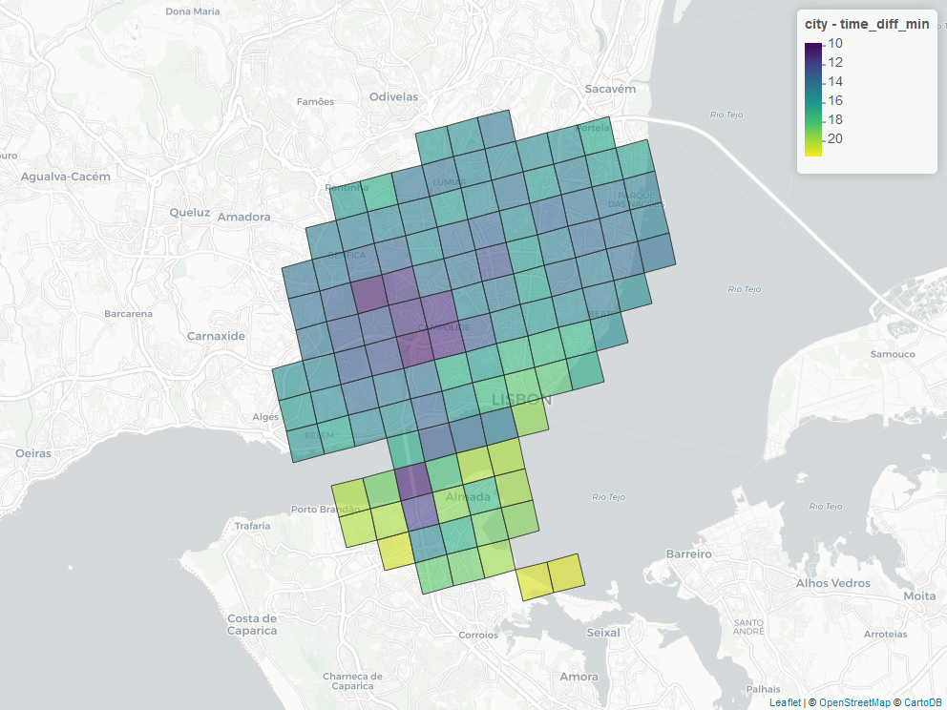
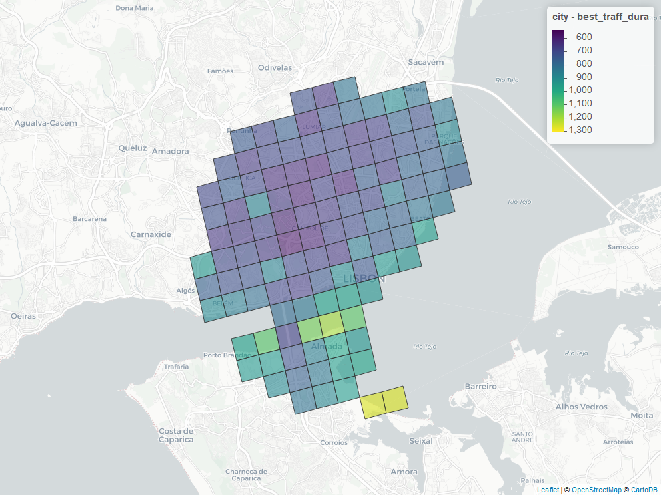
LISBON

Slide 13
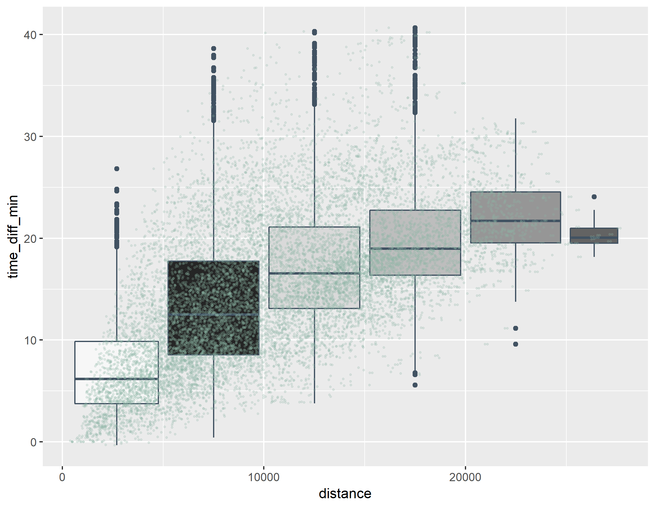
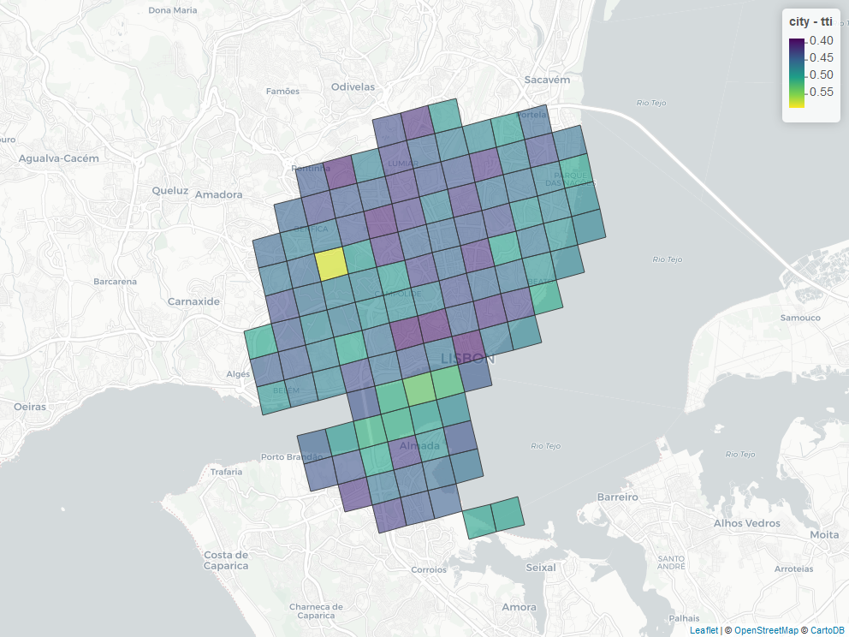
lisbon

Slide 14
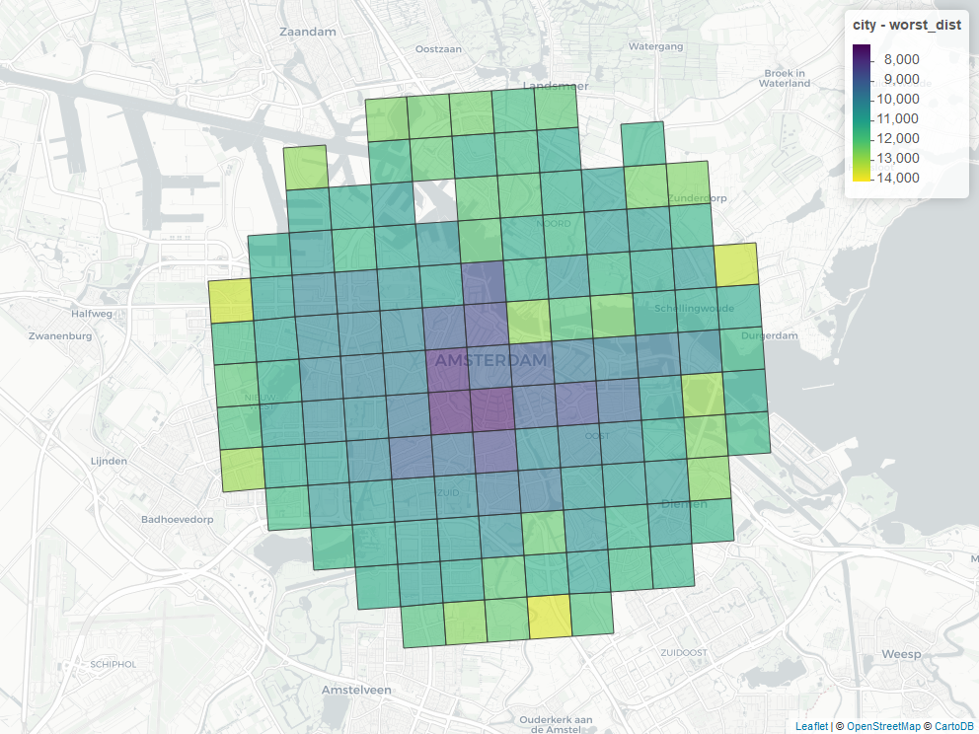
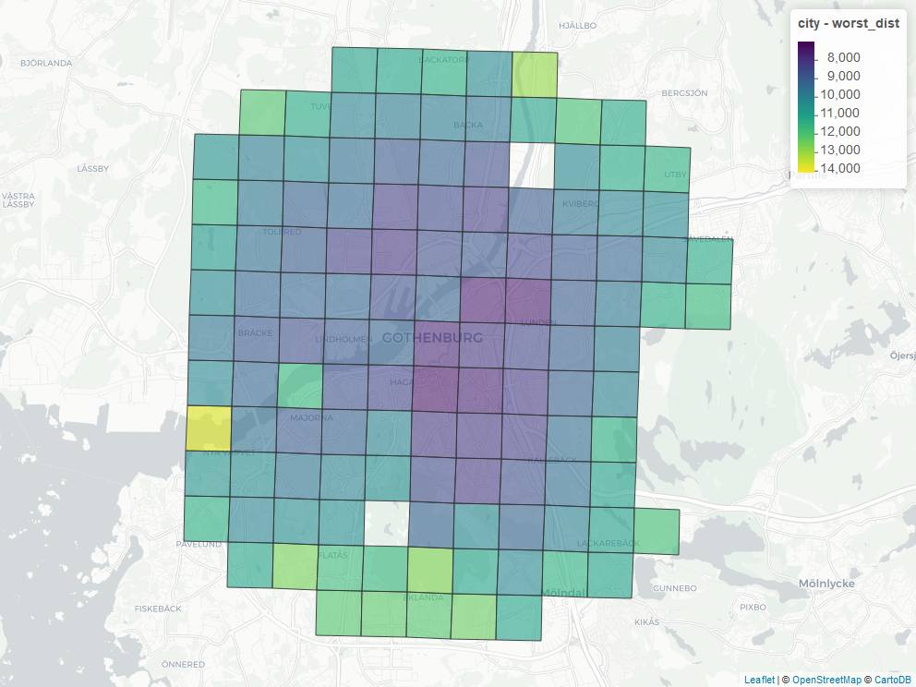
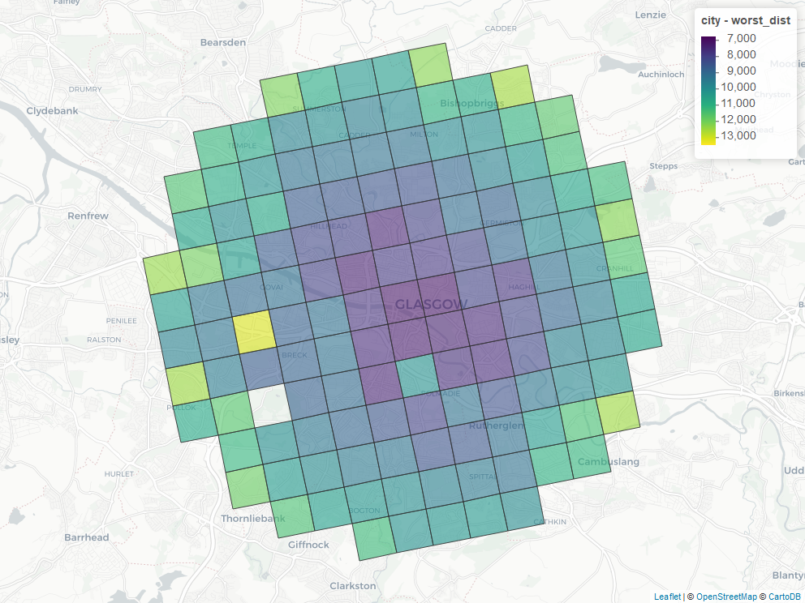
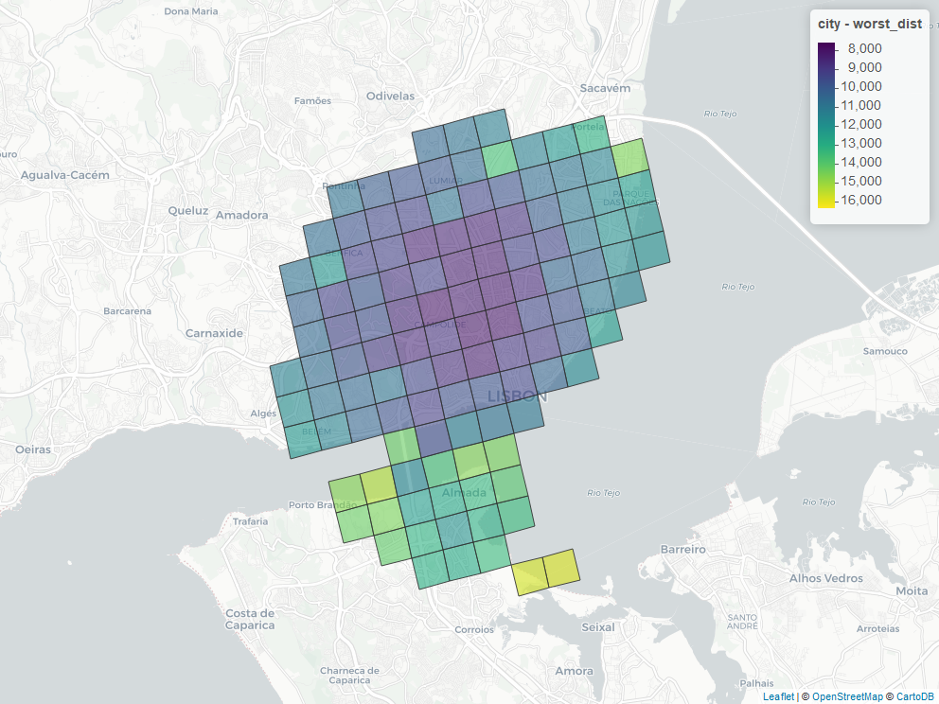
distance
GOTEBORG
AMSTERDAM
GLASGOW
LISBON

Slide 15
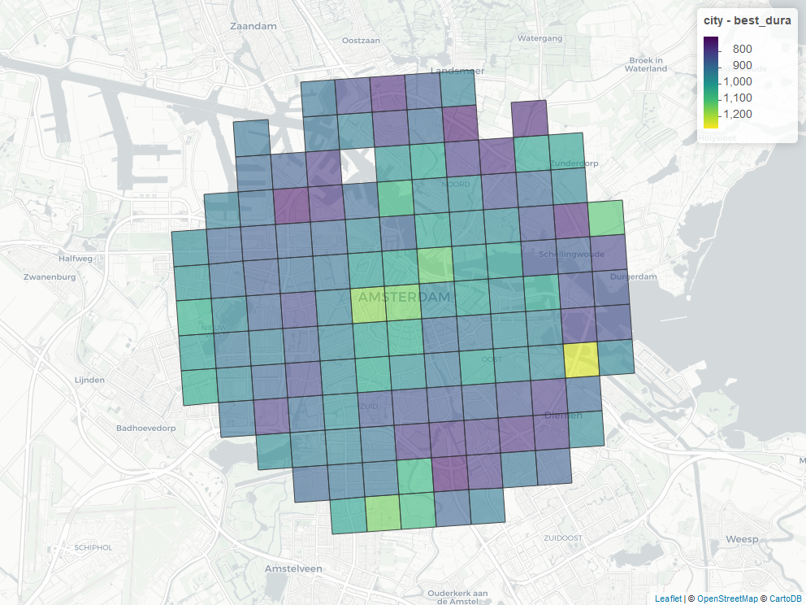
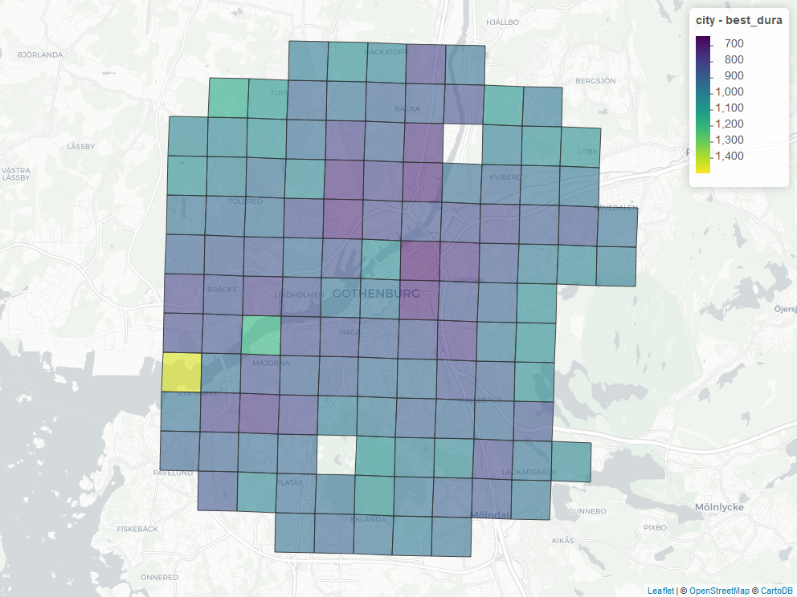
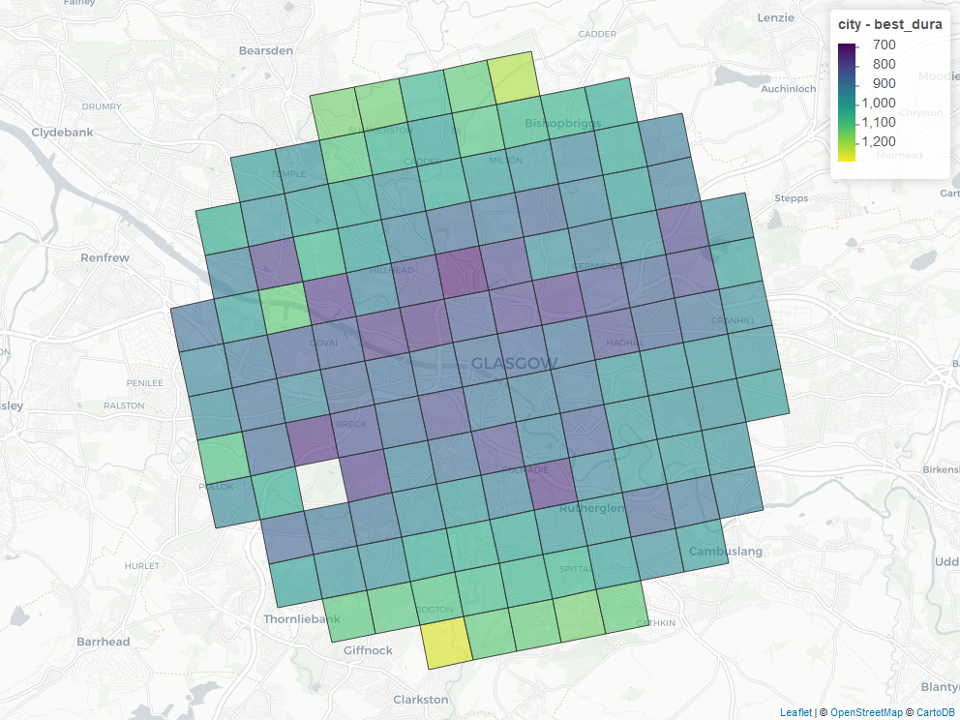
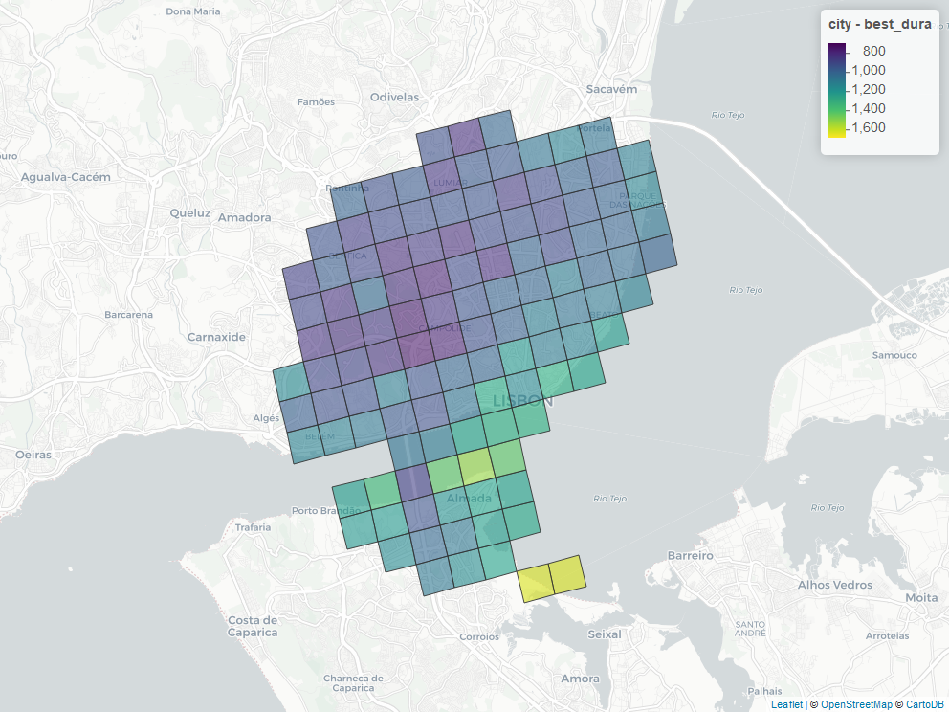
Average time
GOTEBORG
AMSTERDAM
GLASGOW
LISBON

Slide 16
Time vs distance
GOTEBORG
AMSTERDAM
GLASGOW
LISBON

Slide 17
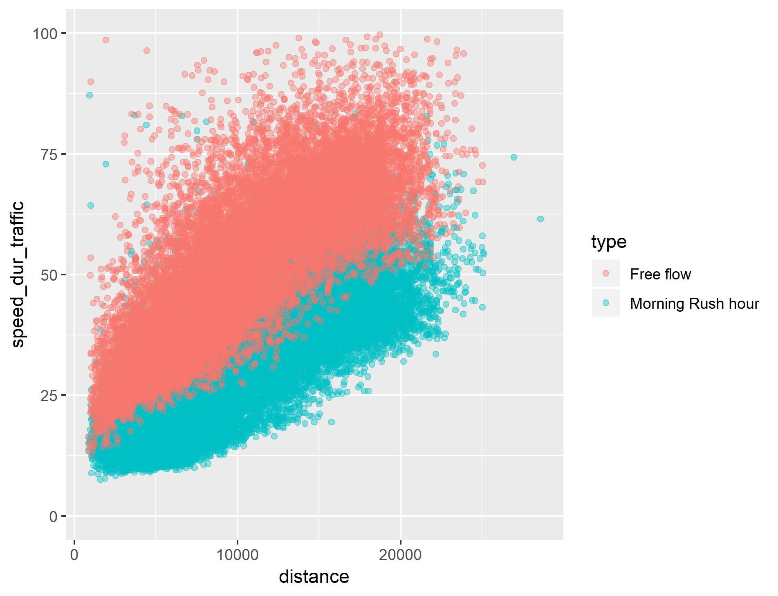
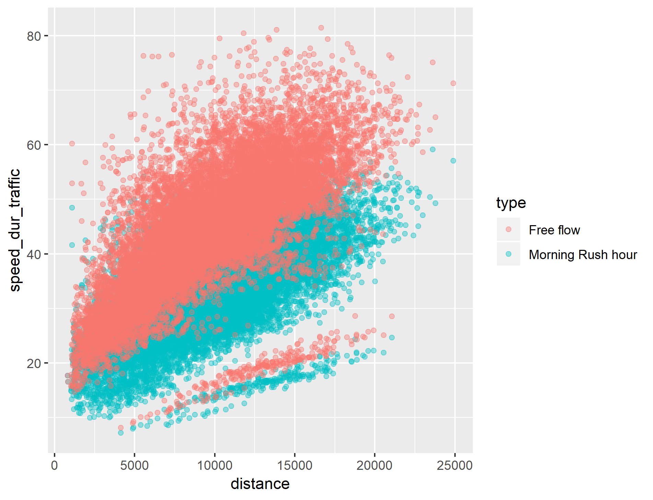
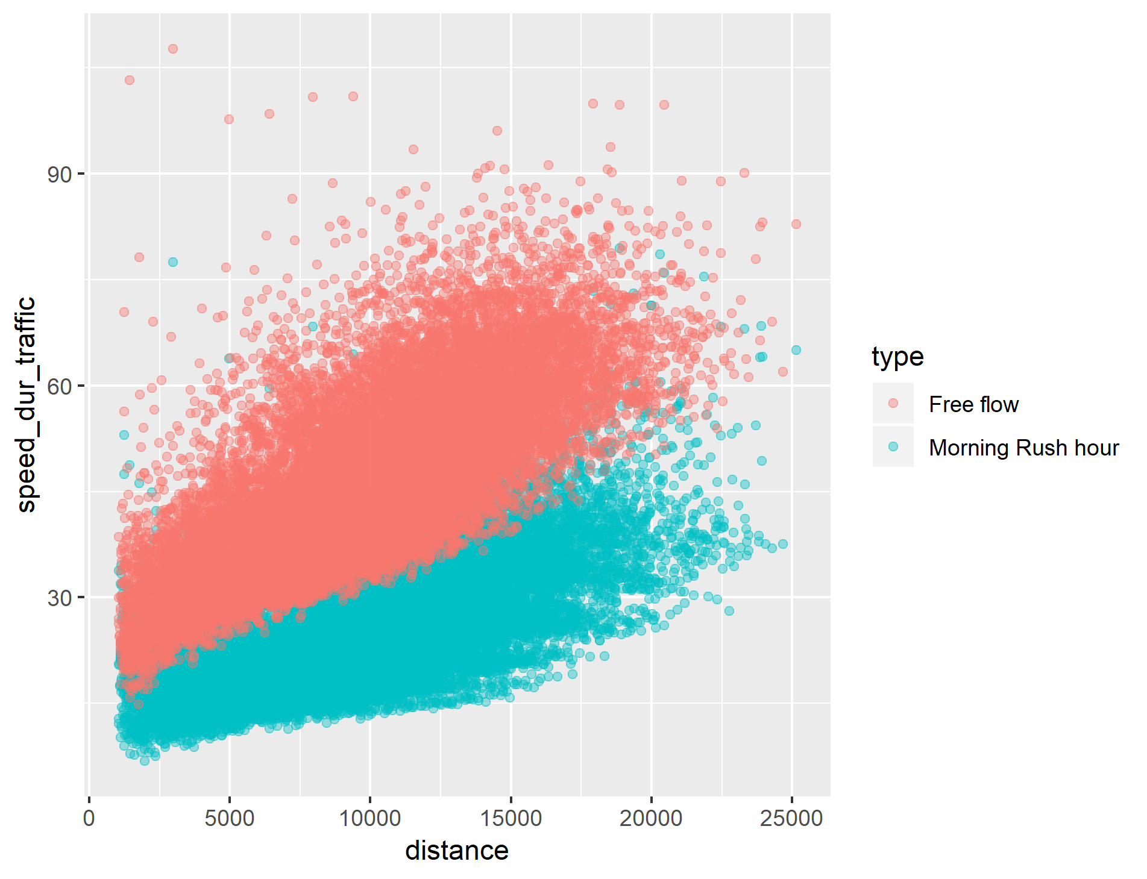
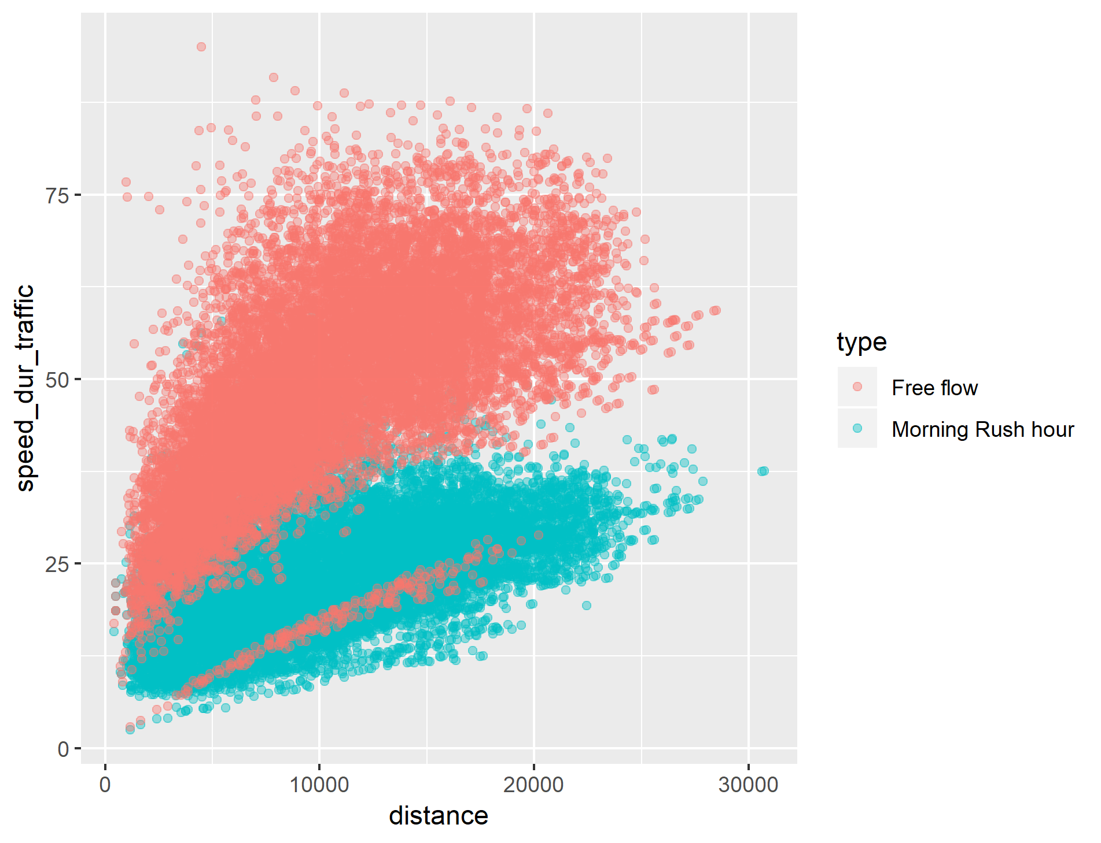
speed vs distance
GOTEBORG
AMSTERDAM
GLASGOW
LISBON

Slide 18
Time histograms
GOTEBORG
AMSTERDAM
GLASGOW
LISBON

Slide 19
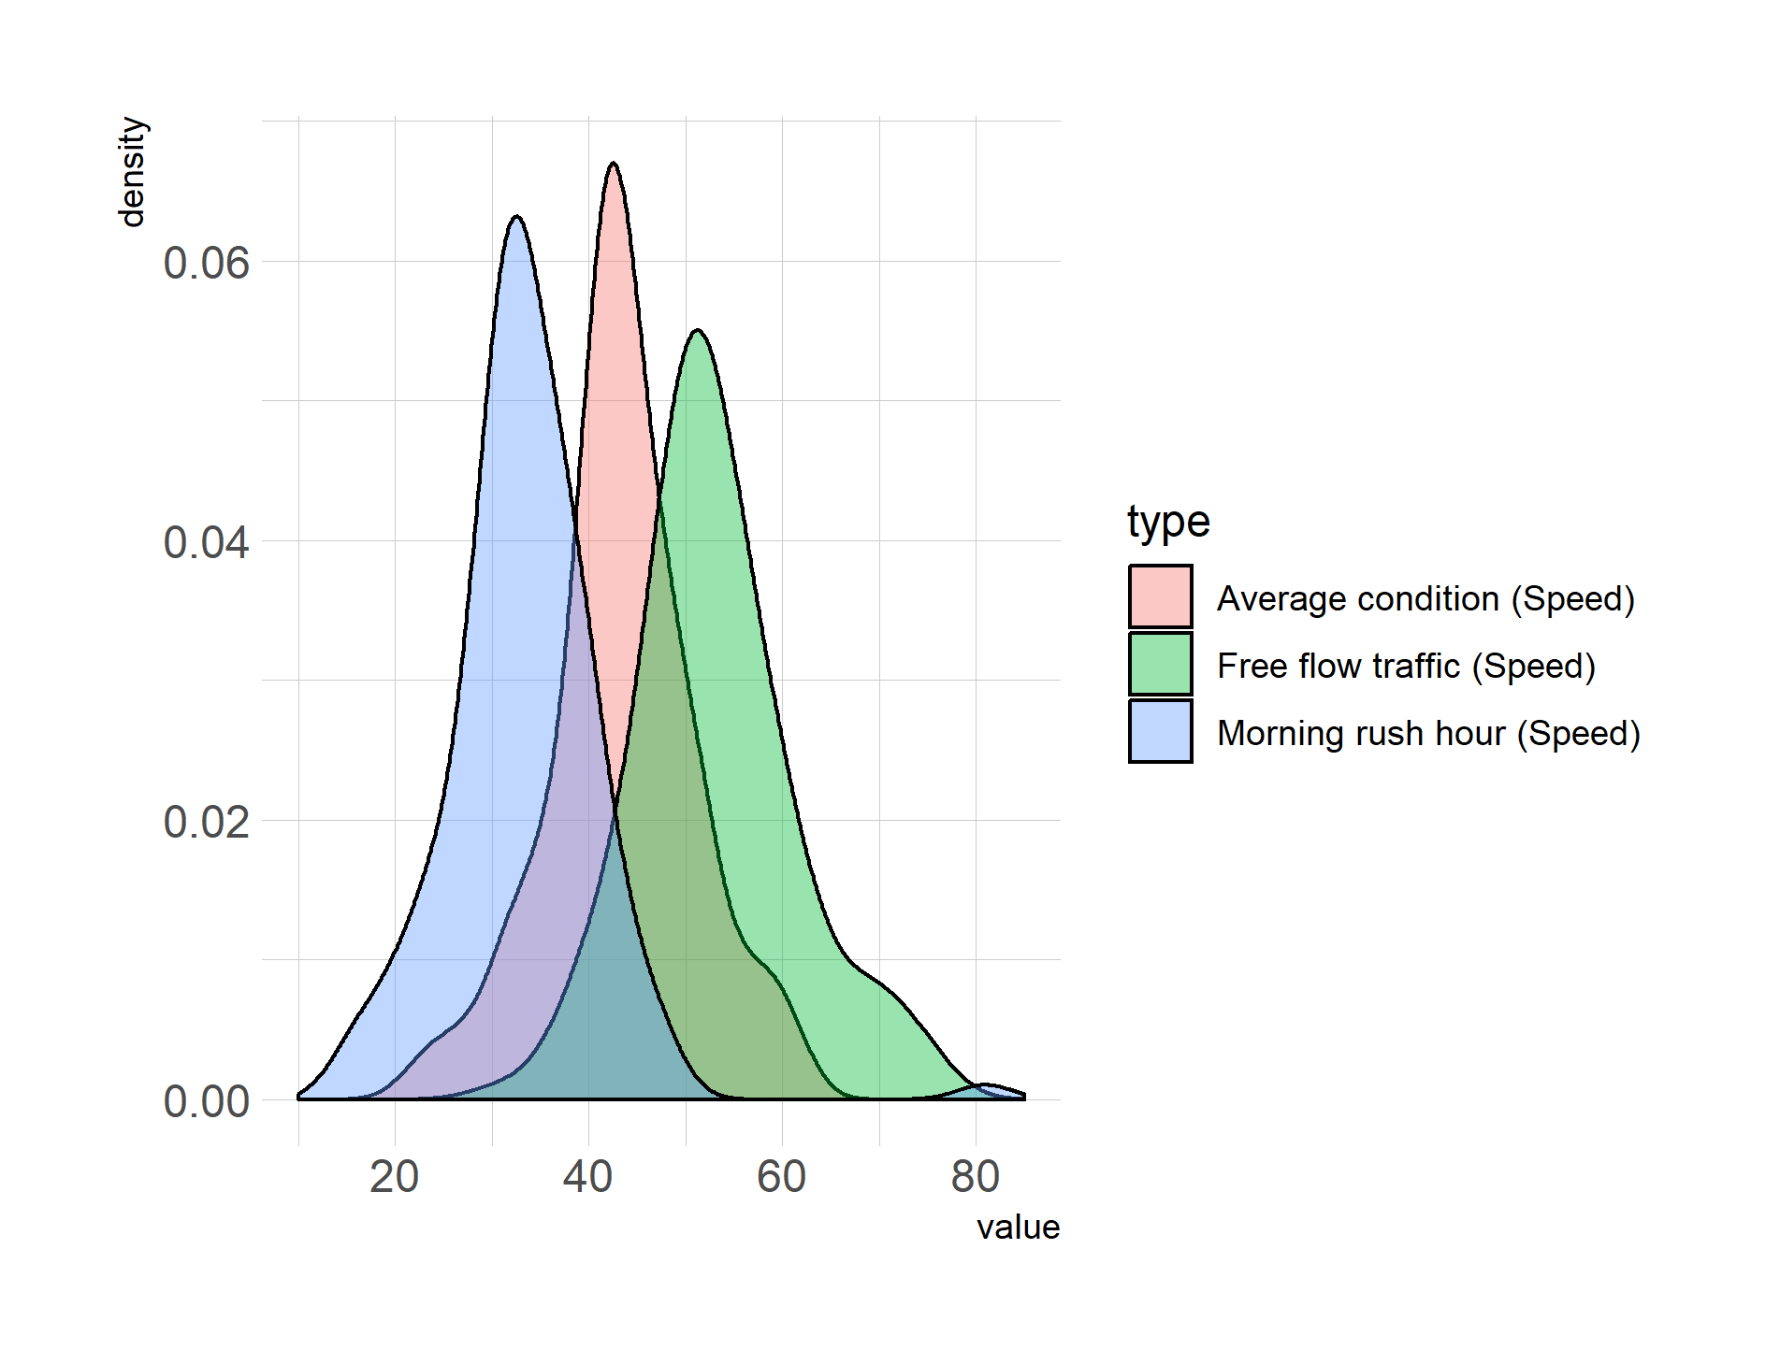
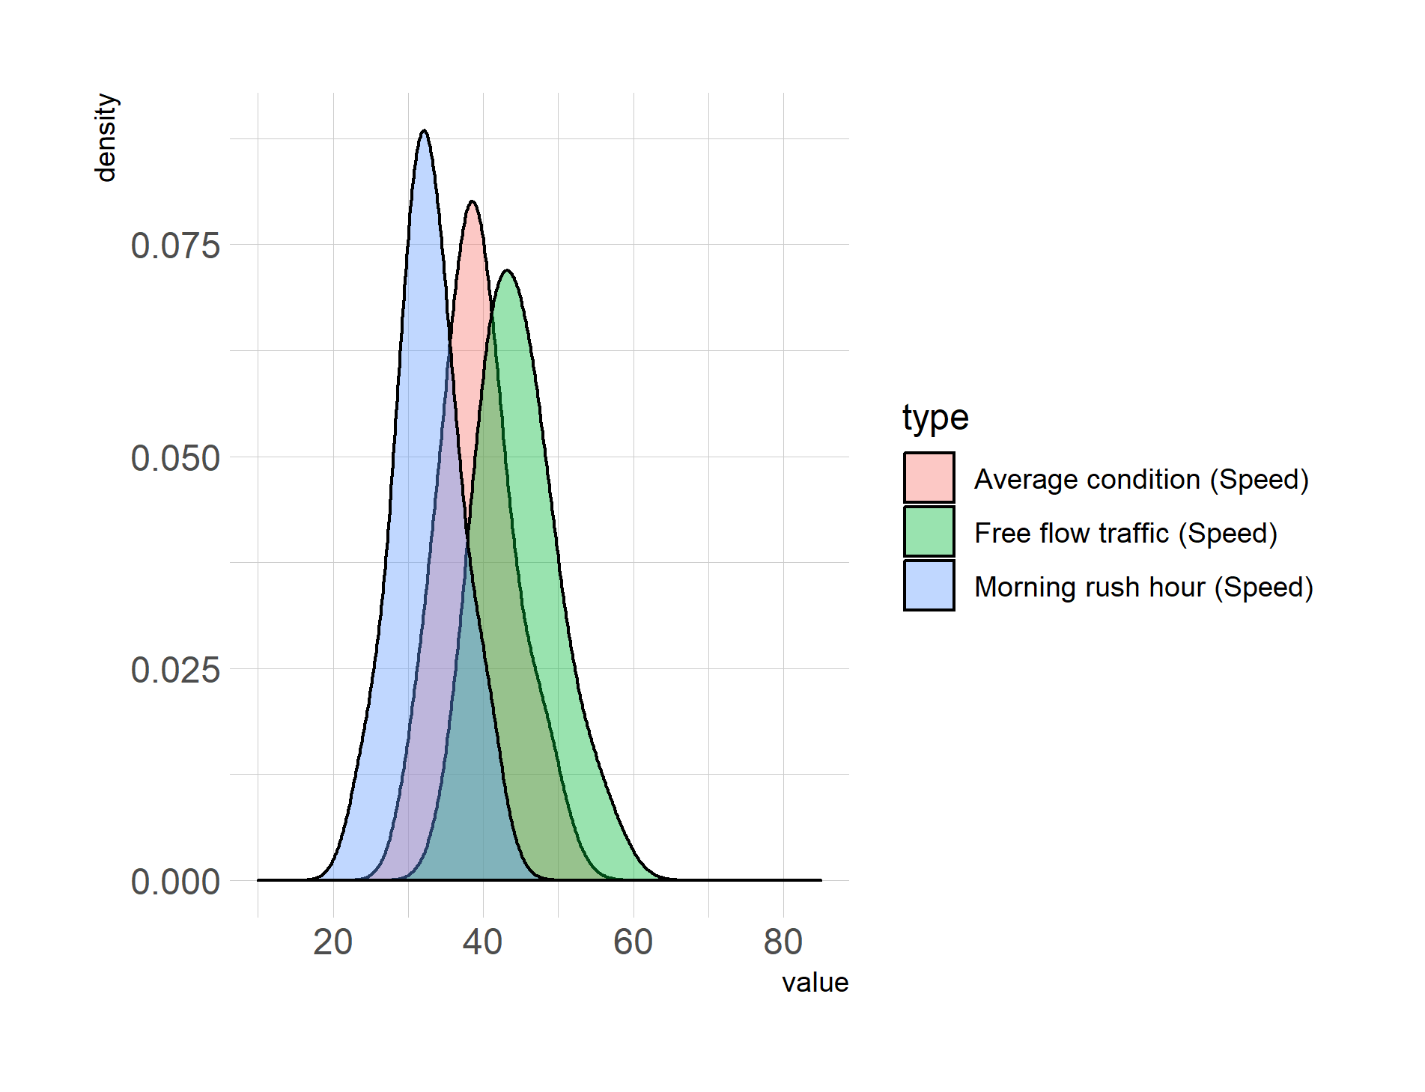
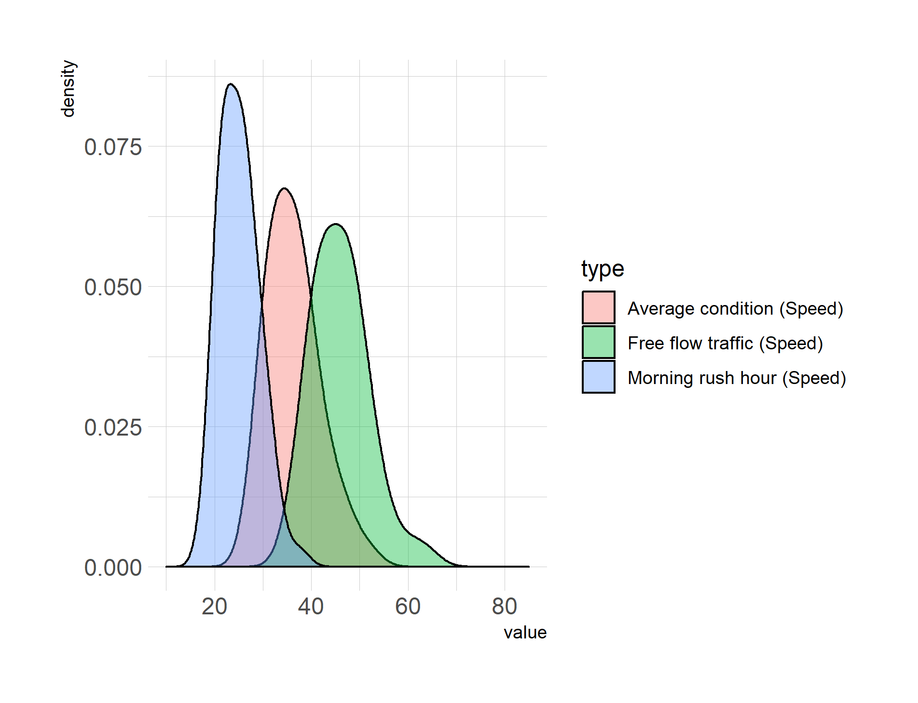
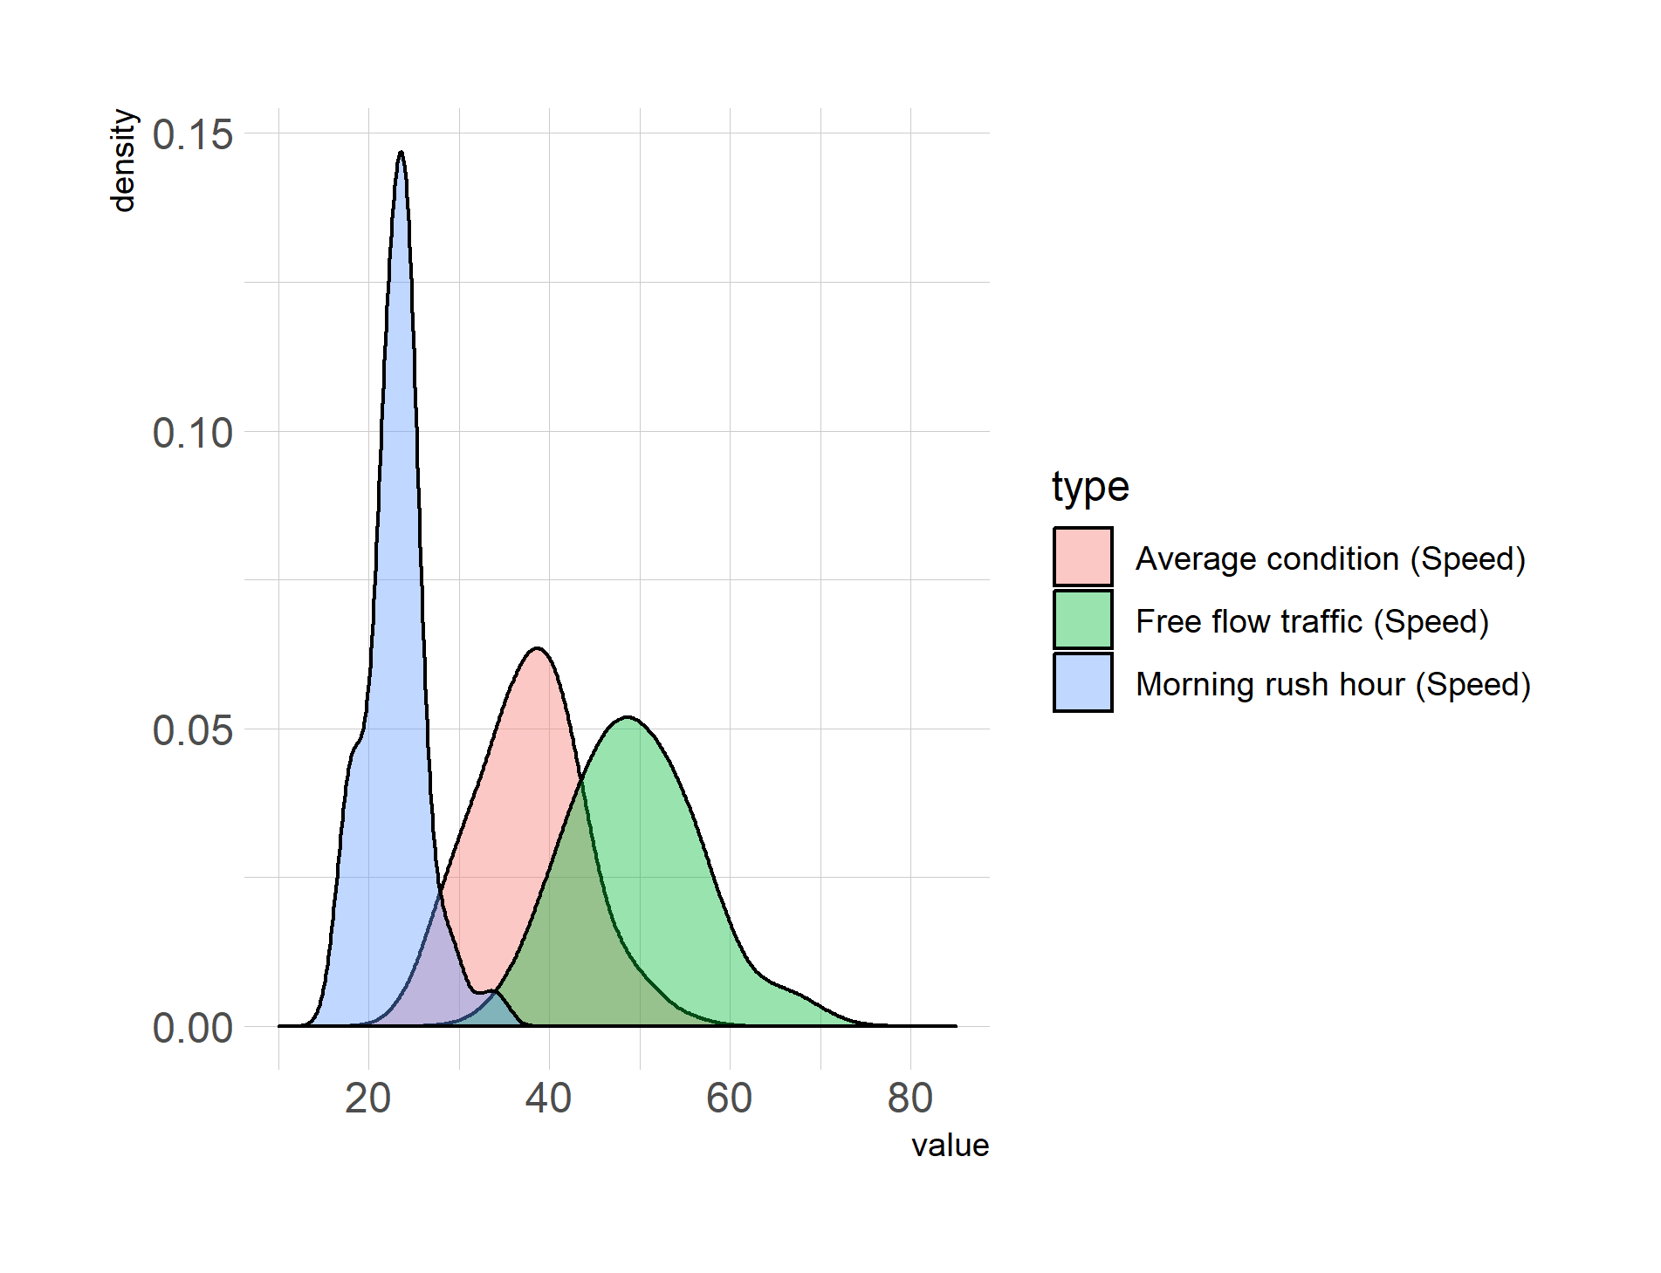
SPEED histograms
GOTEBORG
AMSTERDAM
GLASGOW
LISBON

Slide 20
Time Difference
GOTEBORG
AMSTERDAM
GLASGOW
LISBON

Slide 21
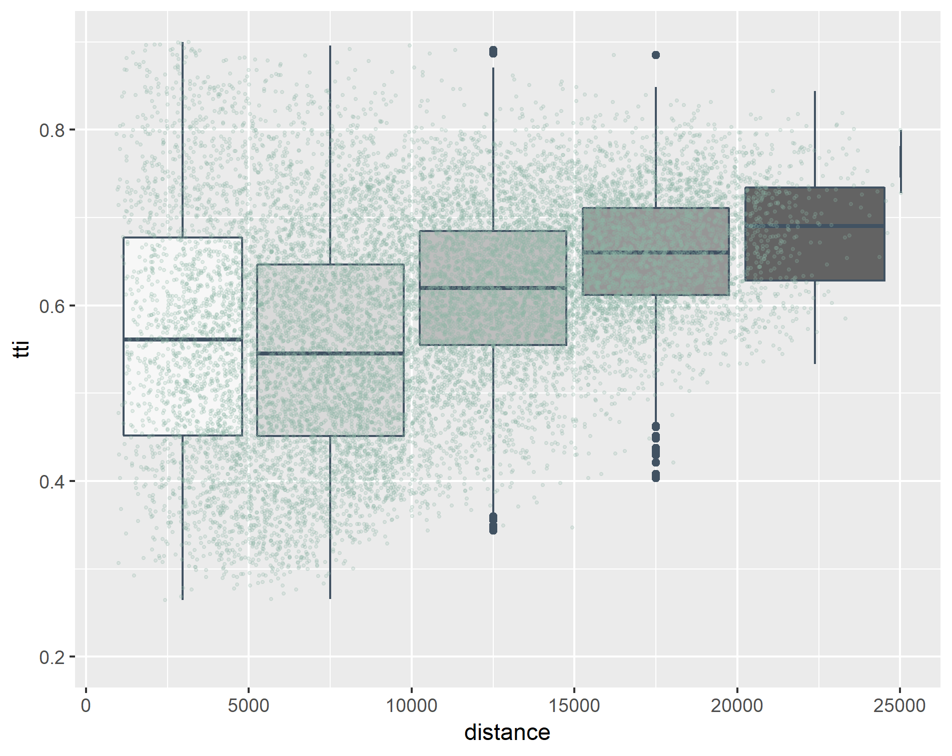
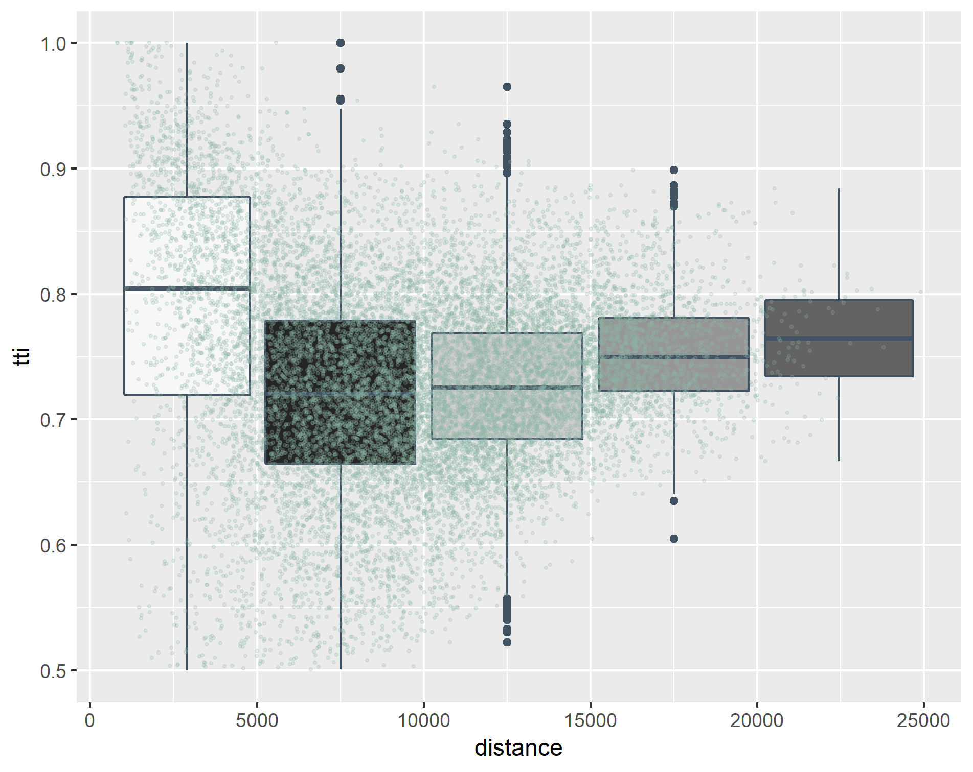
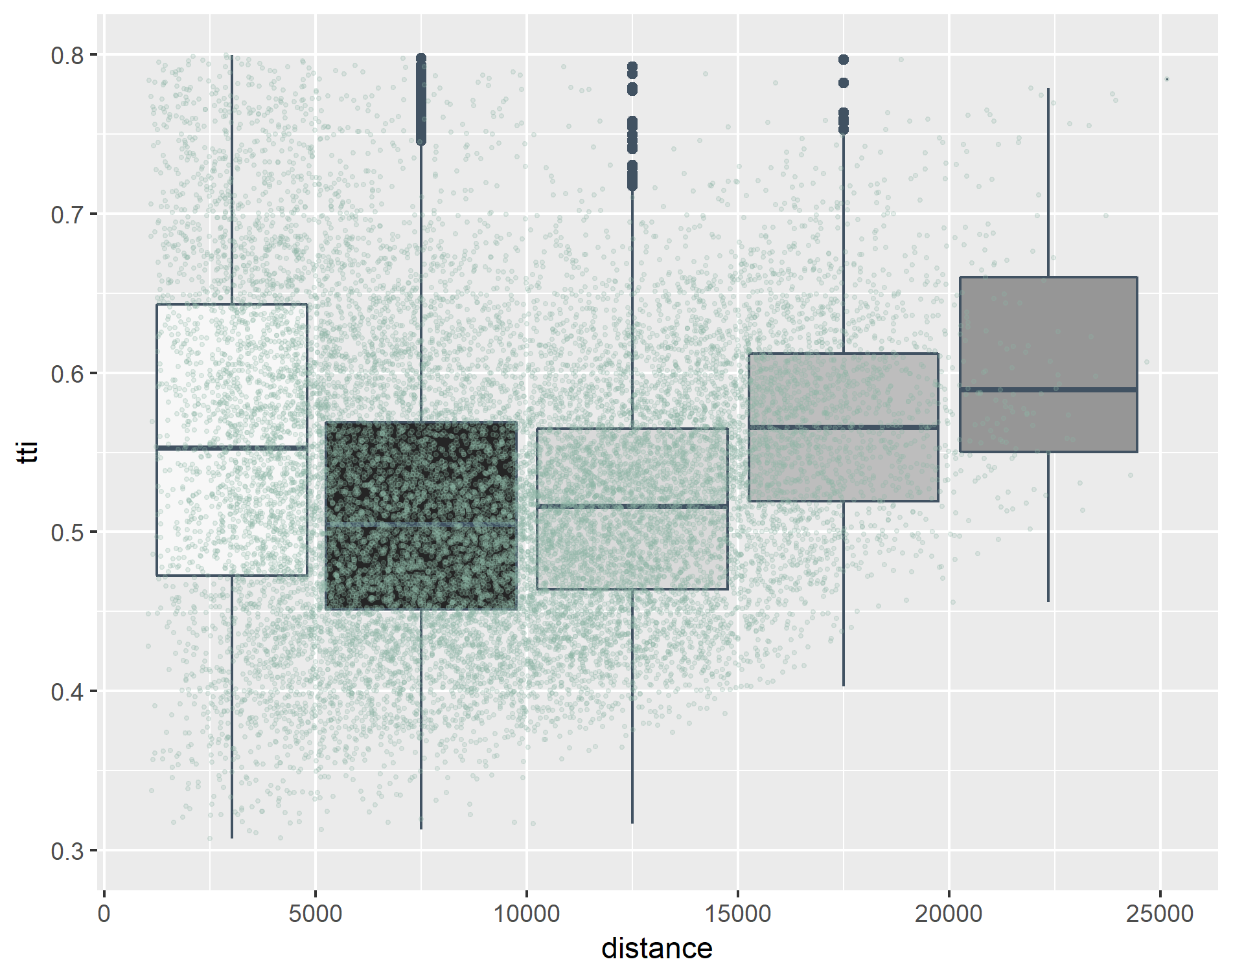
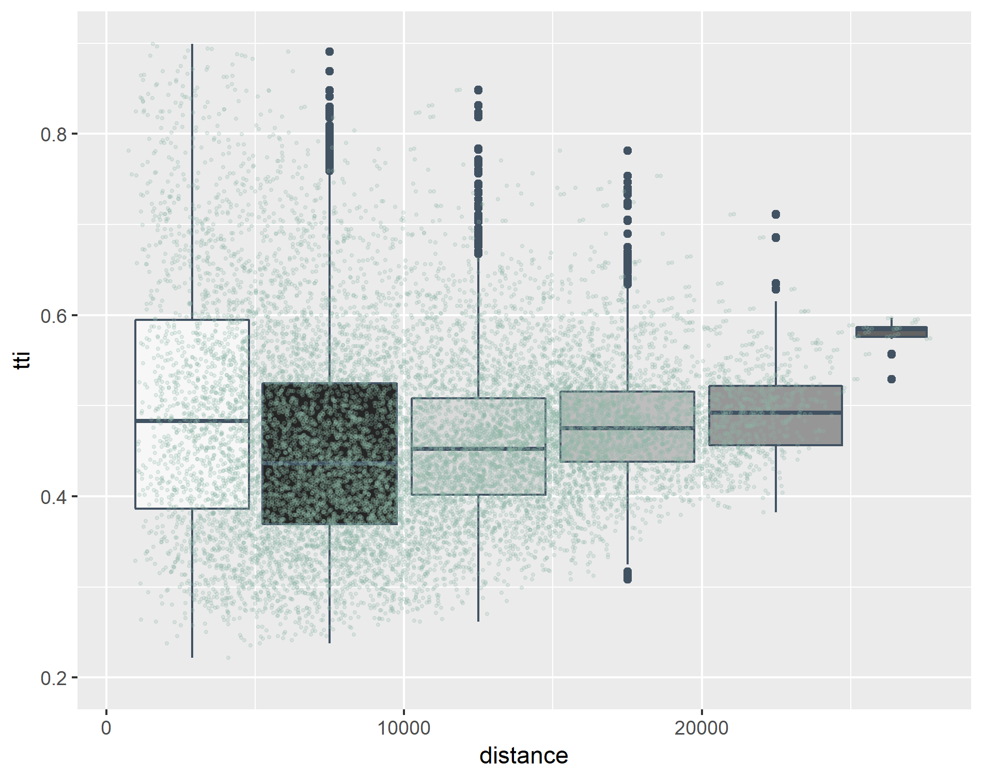
GOTEBORG
AMSTERDAM
Time Difference
GLASGOW
LISBON

Slide 22
profiles
AMSTERDAM
GLASGOW
GOTEBORG
LISBON

Slide 23
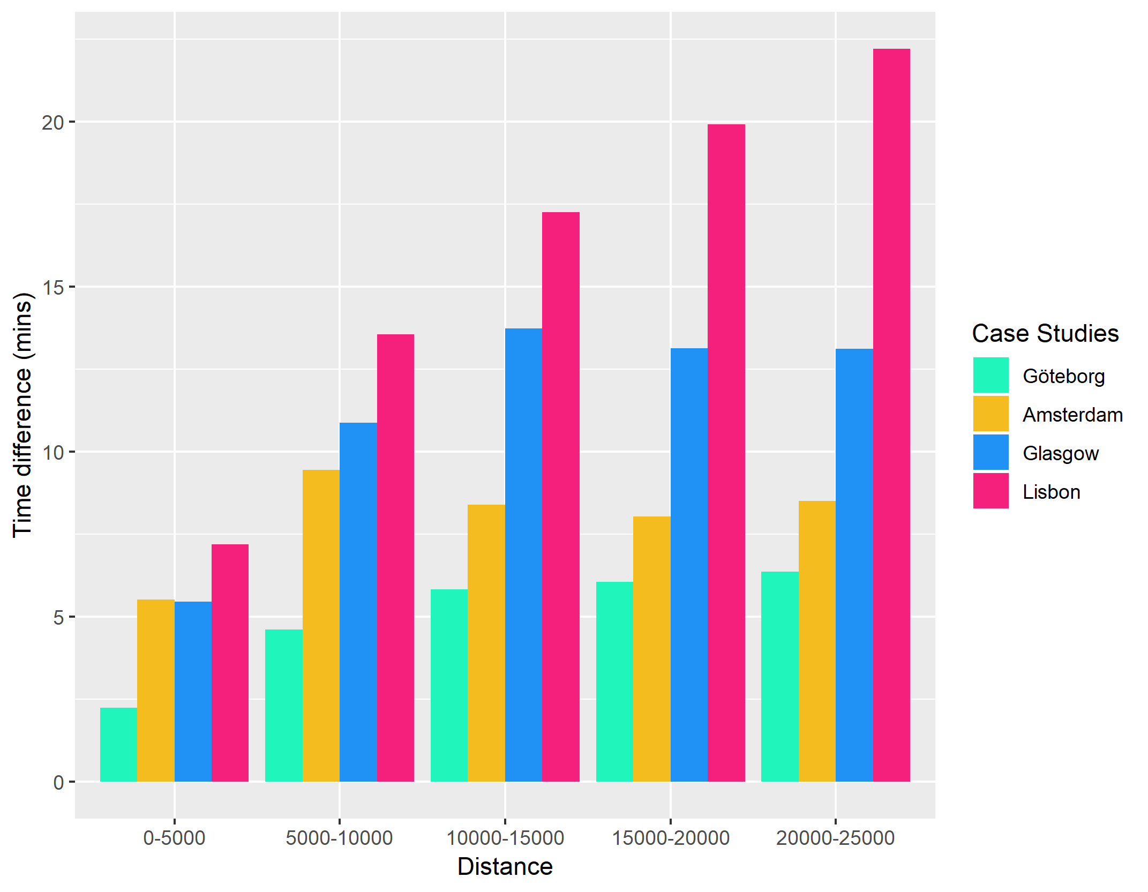
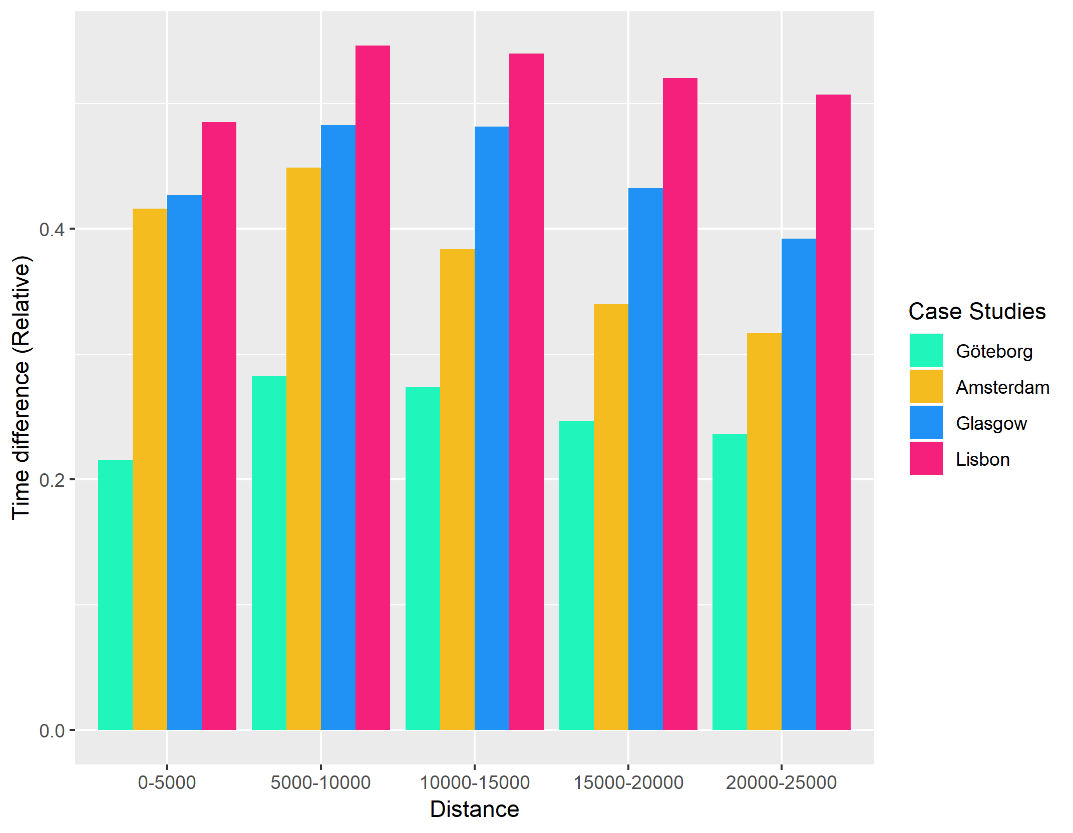

Mean values

Slide 24



Mean values

Slide 25

overall

Slide 26

comparison

Slide 27

comparison

Slide 28


comparison

Slide 29


comparison

Slide 30


Time difference

Slide 31


Time difference (FLEX)

Slide 32


Time rel

Slide 33


Time rel (FLEX)

Slide 34


TTI

Slide 35


TTI (FLEX)

Slide 36


https://mobility.tamu.edu/umr/congestion-data/

Slide 37
INRIX CONGESTION INDEX
http://inrix.com/scorecard/

Slide 38




https://www.tomtom.com/en_gb/traffic-index/ranking

